Slide 1

Integrating Restorative Practices within a Multi-tiered
System of Support
OCDE MTSS Conference
April 2015
Lucy A. Vezzuto, Ph.D.

Slide 2
A Circle
Name, School, District
What is your interest in restorative practices?

Slide 3
Restorative Practices in Schools are inspired by the philosophy and practices of restorative justice, which puts repairing harm done to relationships and people over and above the need for assigning blame and dispensing punishment.
Source: Lucille Eber. 7th Annual NYC PBIS Leadership Summit June 13, 2014
Notes:
Criminal justice field restorative justice; outcomes positive for victims and offenders alike, including reduction in reoffending
Restorative means to believe that decisions are best made and conflicts best resolved by those most directly involved in them.
NOT MERELY A DISCIPLINE APPROACH; WAY TO ACTIVITY ENGAGE KIDS IN TAKING RESPONSIBILITY IN LEARNING AND ENHANCES TEACHING AS WELL.
PARTICIPATORY STRATEGIES HAVE PRACTICAL implications for educating young people to take responsibility outside of school
LANGUAGE IS IMPORTANT AS ‘PRACTICES’ COMPATIble with education in that it supports a prevention and intervention approach. Not about criminal behavior at the far end of the behavioral spectrum. It conducive to our focus on school climate and building community.

Slide 4

SCHOOL-TO-PRISON PIPELINE
Juvenile Detention
or Secure Commitment
Re-entry
SCHOOL
Suspension & Expulsion
Dropping
Out
Adult Prison
http://www.dignityinschools.org/taxonomy/term/71

Slide 5
California Education Code
ED Code 48900.5. states: (a) Suspension, …, shall be imposed only when other means of correction fail to bring about proper conduct.
(b) Other means of correction include, but are not limited to, the following:
  Participation in a restorative justice program.
  A positive behavior support approach with tiered interventions that occur during the school day on campus.

Slide 6
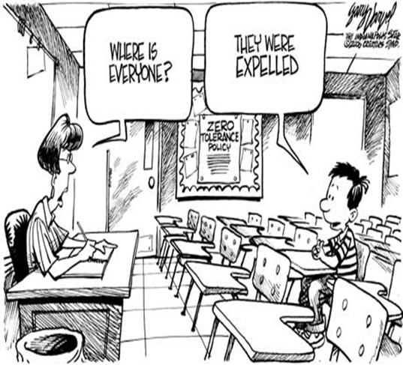

Slide 7
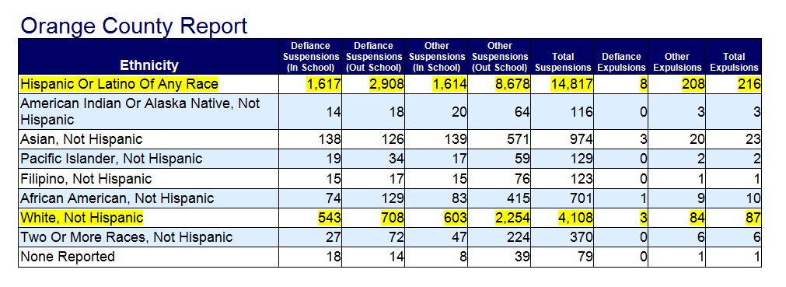
Education Code 48900(k)
Defiance Suspension and Expulsion
Calif. Dept of Education 2013-14
Notes:
The California Dept. of Education and the State Superintendent have advocated for the reduction of suspension and expulsions on campus through the use of restorative justice and practices (CDE, 2015). The restorative approach is also recommended to address disparities in discipline among students of color that result in loss of instructional time.
Willful defiance became identified with the problem of high rates of expulsions and suspensions after the CDE reported a high number of minority students were suspended for this cause. Those figures helped spur the passage of Assembly Bill 420, supported by the CDE …. The bill, signed into law last year, limits suspensions and expulsions for disruptive behavior in certain grades” (CDE, 2015).
General Description of this Report
This report provides a count of students who were involved in one or more incidents¹ during the academic year in which the most severe offense committed by the student was a violation of California Education Code Section 48900(k), otherwise known as "Defiance," and who were subsequently suspended or expelled² from school as a result of the incident.
Counts of students involved in all other incidents in which the most severe offense was something other than Defiance are provided for contrast (see Glossary).
¹An incident is defined as one or more students committing one or more offenses on the same date at the same time.
²Expulsion counts include all expulsions, even those expulsions where the term of the expulsion has been shortened or the enforcement of the expulsion has been suspended.

Slide 8
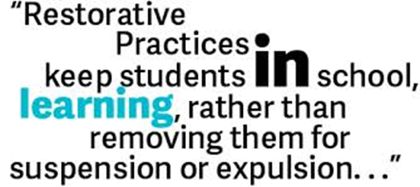

Slide 9
What are Restorative Practices (RP)?
Restorative Practices are a framework for building community and for responding to challenging behavior through authentic dialogue, coming to understanding, and making things right.
IIRP
Notes:
When conflict occurs…
Victims and wrongdoers work together to repair the harm caused
RP encourages dialogue between the victim and offender and emphasizes values of empathy, respect, honesty, acceptance, responsibility and accountability

Slide 10
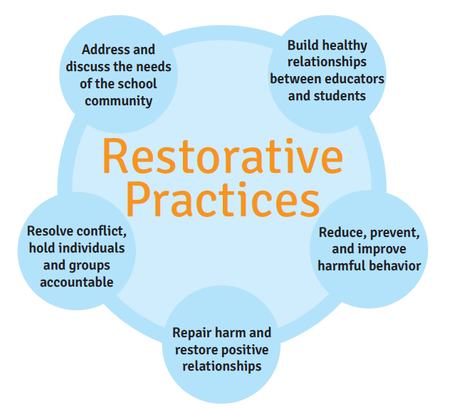

Slide 11
Core Philosophy
of Restorative Practices
Human beings are happier, more productive and more likely to make positive changes in their behavior when those in positions of authority do things WITH them, rather than TO them or FOR them.
Ted Wachtel
Founder,
International Institute for Restorative Practices

Slide 12
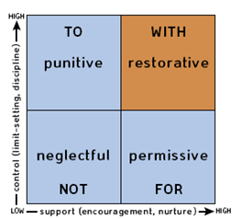
Social Discipline Window
Notes:
Response to wrongdoing
Go beyond punitive to permissive continuum
Control and supports
HELP TEACHERS REFLECT ON THEIR APPROACH USING THIS MATRIX. AND UNDERSTNANDNG RESTORATIVE IS BOTH HIGH CONTROL AND HIGH SUPPORT

Slide 13
Paradigm Shift
Adversarial
Restorative
What rule was broken?
Who’s to blame?
What punishment does the offender deserve?
Who was harmed?
What harm resulted?
What needs to be done to make things right?

Slide 14
A Continuum of Restorative Practices
Affective Statements
Small Impromptu Conference
Formal Conference
Group or Circle
Affective Questions
McCold & Wachtel, 2001

Slide 15
Affective Questions
When Challenging Behavior
To Help Those Affected
  What happened?
  What were you thinking of at the time?
  What have you thought about since?
  Who has been affected by what you have done? In what way have they been affected?
  What do you think you need to do to make things right?
What did you think when you realized what had happened?
What impact has this incident had on you and others?
What has been the hardest thing for you?
What do you think needs to happen to make things right?
Notes:
Conflict is part of life. As educators we continually deal with it.
RP helps us rethink our approach to turn misbehavior and conflict into an opportunity to learn and build better relationships.
Emphasis is on natural consequences rather than punishment that excludes and doesn’t restore relationships or allow her restitution.
Think of a recent discipline scenario that occurred at your school. Practice using the Restorative Questions with a partner.
What did you observe?

Slide 16
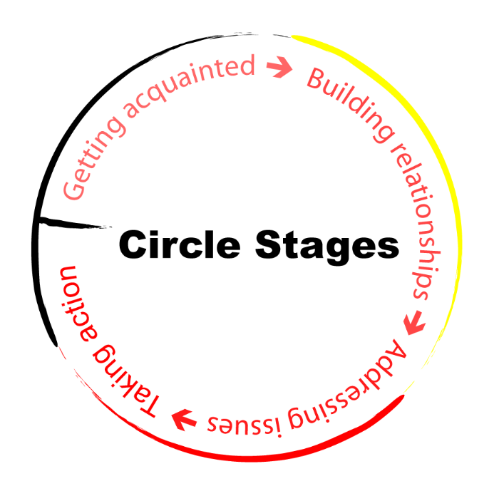

Slide 17


Slide 18
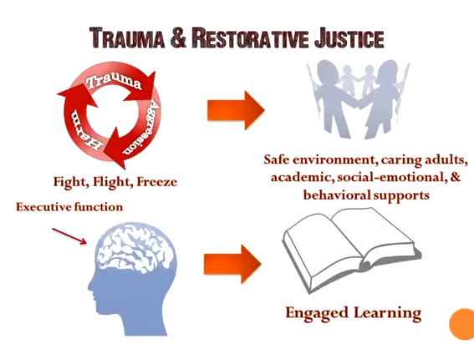
Trauma and Restorative Practices
Notes:
TRAUMA RESPONSE NEEDS;
PREDICTABILITY,
SAFETY
LISTENING TO THE STORY
WAY TO DE-ESCALATE EMOTIONS AND HELP TO REGULATE EMOTIONS AND THE STRESS RESPONSE.
NEUROSCIENCE

Slide 19
Integrating Restorative Practices into A Multi-tiered Framework
Prevention & Intervention

Slide 20
Integrating Restorative Practices into A Multi-tiered Framework
Repair Harm & Restore Relationships
Formal restorative conference
Repair Harm & Restore Relationships
Impromptu conferences
Circles for problem-solving & conflict resolution
Build Community & Relationships
Community-Building Circles (students & staff)
Affective Questions
Affective Statements
Prevention & Intervention

Slide 21
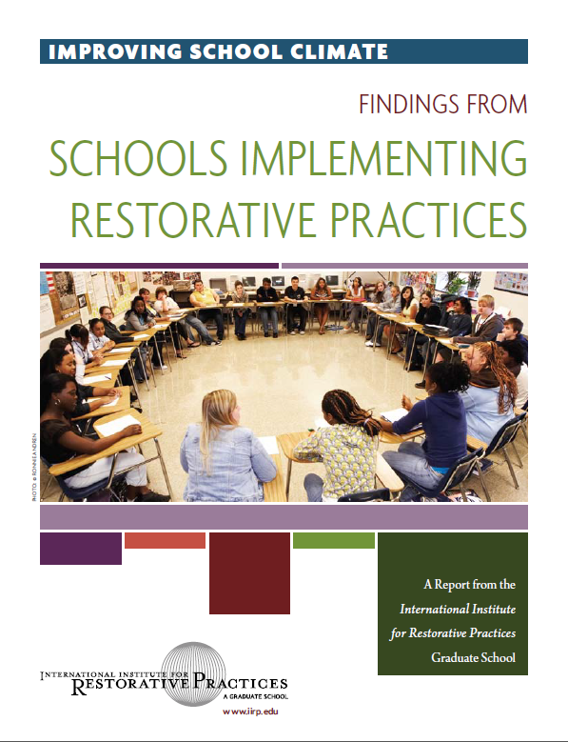

Slide 22
Whole-School Outcomes with Implementation Fidelity
REDUCED
Misbehavior
Violence & bullying
Suspensions & expulsions
Teacher & student absenteeism
INCREASED
Instructional time
Safety
IMPROVED RELATIONSHIPS & ATTTITUDES AMONG
Students, staff, administration and parents
IIRP, 2011

Slide 23
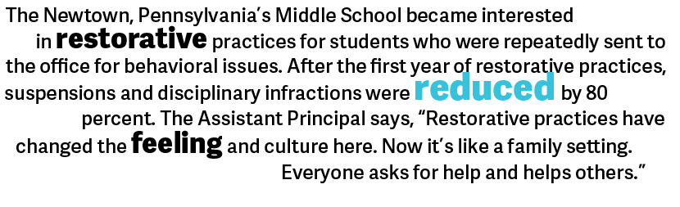

Slide 24
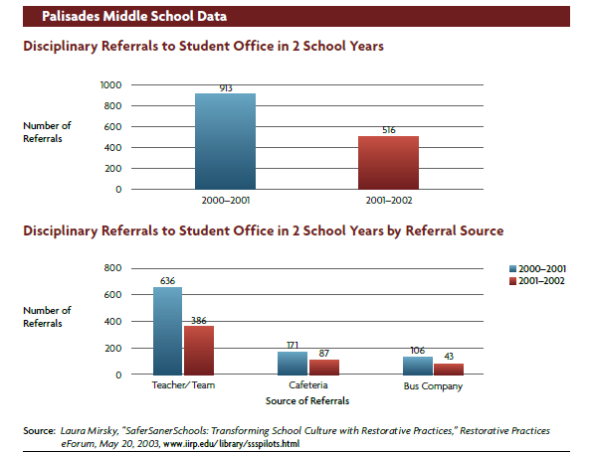
Notes:
Rural Fringe Middle School
grades 6–8
37 Teachers
529 Students
›› Grade 6: 179
›› Grade 7: 176
›› Grade 8: 174

Slide 25
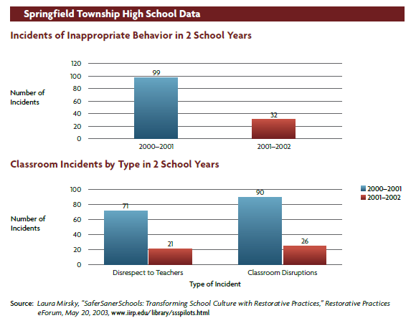
Notes:
Large Suburban High School
grades 8–12
68 Teachers
834 Students
›› Grade 8: 154
›› Grade 9: 159
›› Grade 10: 157
›› Grade 11: 200
›› Grade 12: 164
Source:

Slide 26
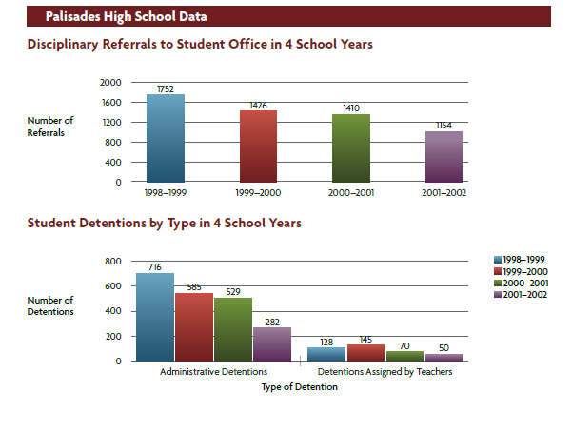
Notes:
Rural Fringe High School
grades 9–12
52 Teachers
743 Students
›› Grade 9: 175
›› Grade 10: 198
›› Grade 11: 205
›› Grade 12: 165

Slide 27
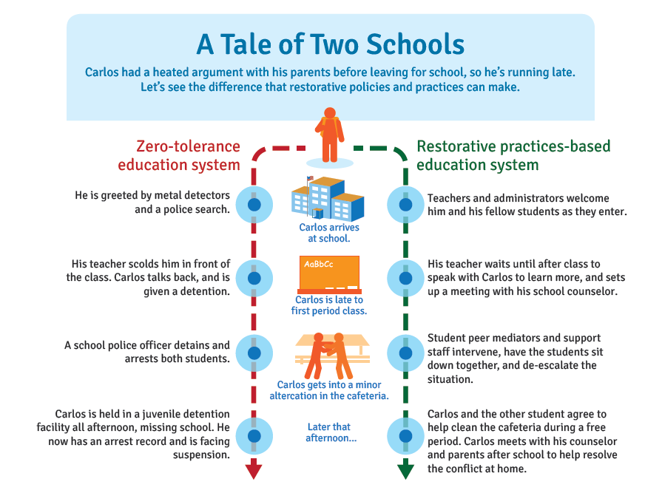

Slide 28
Integrating & Implementing Restorative Practices
Have a PBIS-MTSS framework in place
Identify desire and need to add value to school’s PBIS program
Determine your school’s capacity to take on a culture shifting set of practices including need, resources and commitment.
Identify interested pioneers

Slide 29
Integrating & Implementing Restorative Practices
Determine interest, capacity & need to:
  Build deeper community & stronger relationships among students and staff
  Use circles for social-emotional and academic outcomes
  Add student, staff, and parent voice to discipline decisions
  Shift from an adversarial to a restorative approach
  Reduce suspensions and expulsions
  Become more whole-learner focused

Slide 30
Orange County Dept. of Education
Restorative Practice Initiative
Support for Your District and School Staff
Ongoing RP trainings for school staff
RP Community Network for implementation support
OCDE PBIS-MTSS training program introducing RP concepts
Support a cadre of trainers
Website of resources & supports
http://www.healthiersf.org/RestorativePractices/media/restorative_practices_and_san_francisco_public_schools_640x360.mp4

Slide 31

Sign up for more info

