Slide 1
A Dialogue about Integrating Restorative Practices into Multi-tiered Systems of Supports and in Schools: Examples, Questions, Challenges and Possible next Steps
Lucille Eber, Director
Midwest PBIS Network and National PBIS TA Center
lucille.eber@midwestpbis.org
January 21, 2015 9:00 to 11:00 AM CST

Slide 2
Sign In
Please let us know who is on the call:
Type your name, title, and district/building in the chat box titled sign in
There is also a chat box in the bottom right of your screen. This is for any comments/questions you may have as we go through this webinar! We encourage chat. It makes the webinar more interactive and interesting.

Slide 3
System Reminders
Our conference call line is integrated with Adobe Connect so phone and web participants can communicate with one another – phone participants may want to mute their computer speakers.
To mute your conference call land line, key *6.
If your are on a cell, please use your mute feature.

Slide 4
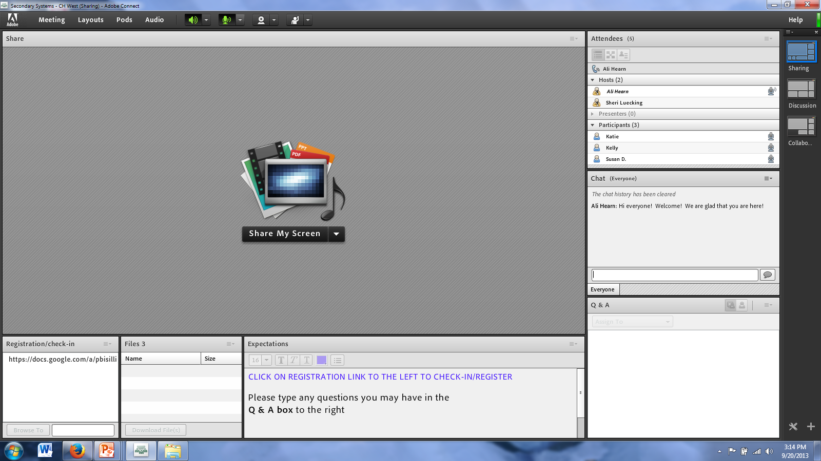
Notes:
Modify to the screen set up Mimi had for Frosh Webinar.

Slide 5
Let’s practice with a poll
Respond to the poll with the corresponding letter:
Is your district/building implementing School Wide Positive Behavior Interventions and Supports (Tier 1)?
Implementing restorative practices (circles, peer juries, conferencing, restorative conversations)?
Doing both?

Slide 6
Today’s Dialogue
Restorative Practices (RP) are being implemented in school across the U.S. as districts seek alternatives to suspension. Many districts are embedding Restorative Practices within SWPBIS as part of their continuum of supports and non-exclusionary consequences.
Midwest PBIS Network is bringing together schools from across Illinois to facilitate a dialogue about the integration of RP into SWPBIS

Slide 7
Big Ideas….
The social context (social validity) of Restorative Practices
Does it have potential as a promising practice?
Examples of efforts to integrate with PBIS
Prevention? Multi-tiered? Alternatives to Suspension?
Can it formally be connected to valid outcomes in schools (academic and social)?
Can a clearly defined logic model, defined core features be established?
How can we establish a model for ‘testing” RJ in schools?

Slide 8
Team-based Thinking
Mike Nelson, Kentucky
Jeff Sprague, Oregon
Kristine Jolivette, GA
Sara Bolygen and Sally Wolf, IBARJ
Jessica Swain-Bradway-Midwest PBIS
George Sugai and UConn Team
Rob Horner, UO

Slide 9
Additional Acknowledgements
Chicago Public Schools
Alton IL School District
Mt Carmel, IL School District
Minnesota Department of Education
Laura Mooiman, Napa Valley School District

Slide 10
New Federal Guidance on School Discipline and Discrimination
Zero Tolerance Does NOT Work…
U.S. Departments of Education and Justice collaborative Supportive School Discipline Initiative refocusing school discipline:
To create safe, positive, equitable schools
Emphasize prevention and positive approaches to keep students in school and learning
For Guidance Package and Additional Resources: http://www2.ed.gov/policy/gen/guid/school-discipline/index.html
….Results in Inequity

Slide 11
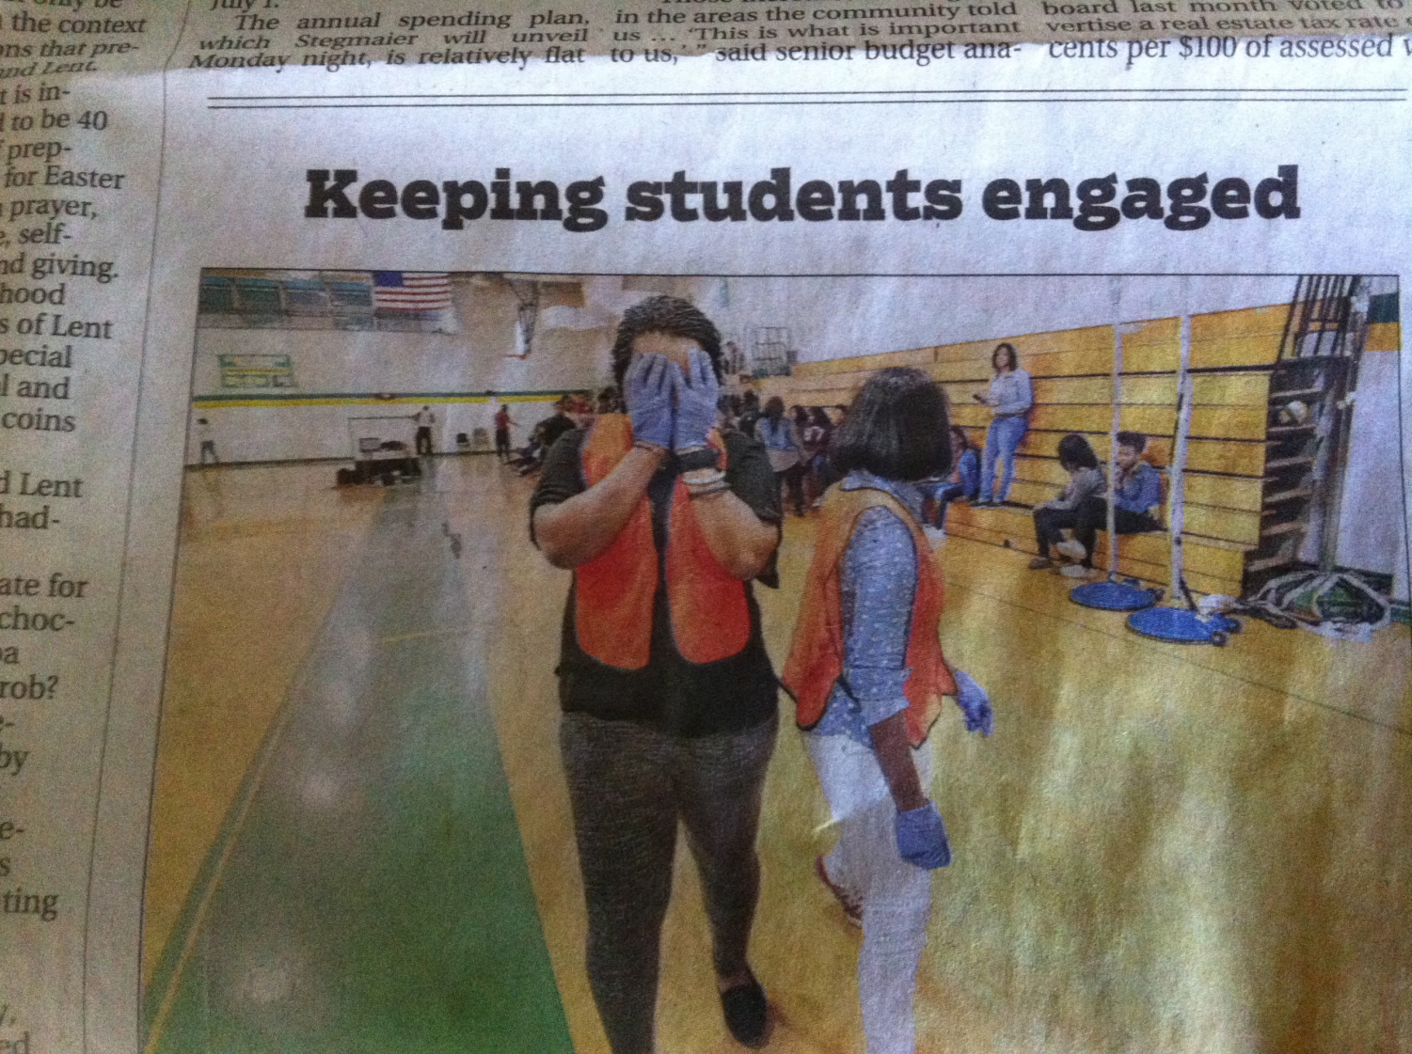
Non Example of Alternatives to Suspension!
Notes:
Alternative to suspensions…the “Scarlet letter approach” …really????

Slide 12
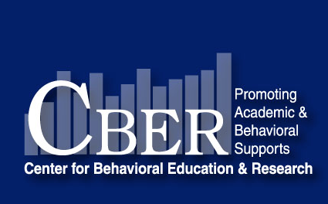

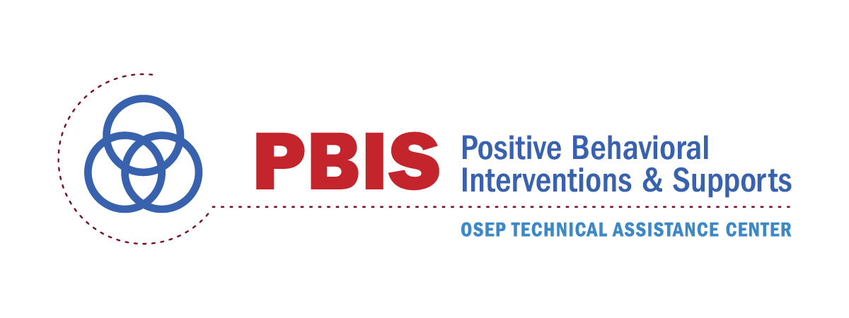
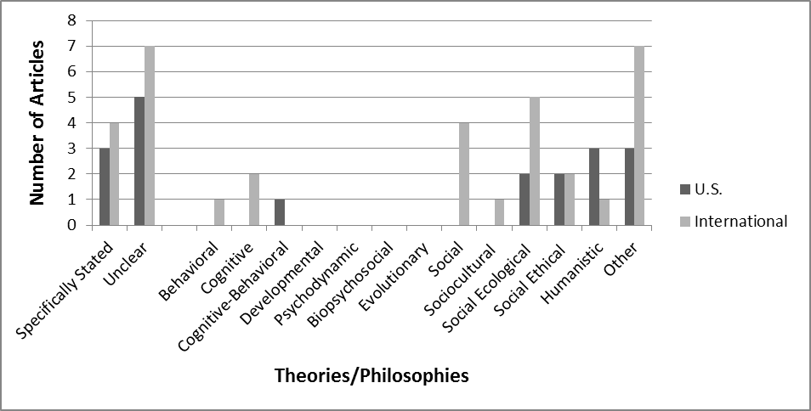
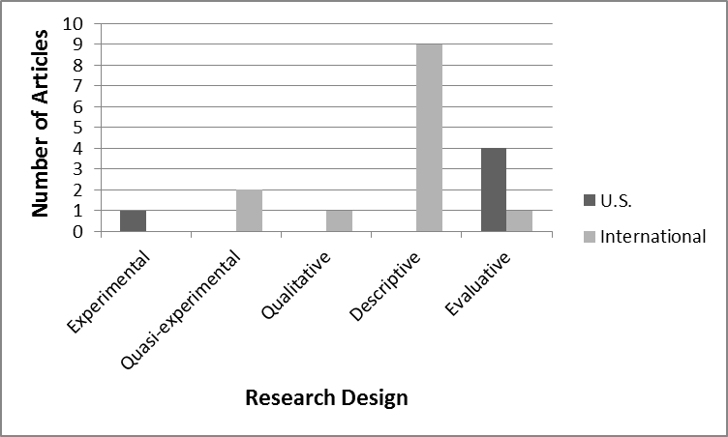
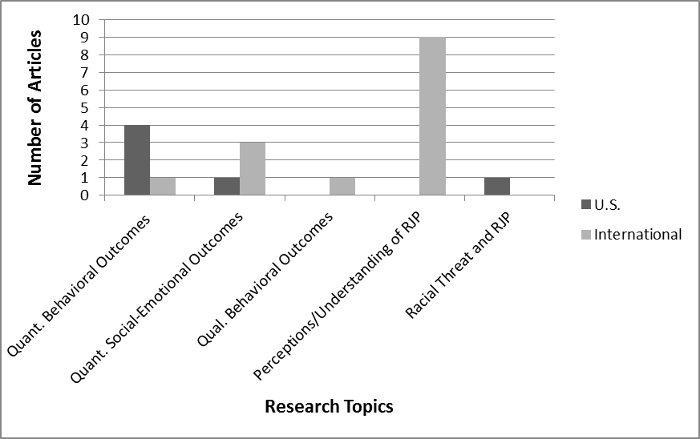
Systematic Descriptive Literature Review of Restorative Justice Practices Marlena Minkos, Sarah Latham, & George Sugai Neag School of Education, University of Connecticut, Storrs, CT
Purpose
Select Findings
Objective 1: Summarize information on restorative justice practices (RJP)
Objective 2: Provide an objective analysis of the research base to inform practitioners, policy makers, and researchers
Objective 3: Develop recommendations regarding adoption of RJP and future research
RJP Overview | Underlying Theory | Research
Definitions highly varied and general in nature More a philosophy or perspective than a theory or practice General overarching principles: repairing harm, accountability, reducing risk, stakeholder involvement, community partnership School-based practices: circles, conferencing, peer mediation, accountability boards | Broad range of theories referenced Many articles did not specifically name a theoretical orientation Several articles referenced 2 or more theories General emphasis on social theories | Limited experimental research base Majority of research studies conducted internationally Qualitative/descriptive methods dominate literature Few articles describe independent variable in detail Little research on behavioral outcomes of RJP
Procedure
Rationale: RJP is an international social reform movement that has taken root in such countries as New Zealand, Australia, the United Kingdom, Brazil, and the United States. It began as early as the 1970’s in the justice system. Some practices date back to ancient Native American and Maori traditions. The RJP movement gained momentum in the 1990’s, coinciding with its introduction in to schools. RJP was recently proposed as a potential model by the U.S. Department of Education in its new Guidelines for School Discipline.
Search: Numerous electronic searches of all databases in UConn’s online library catalog were conducted using keywords designed to screen for school-based RJP theory, program descriptions, and research studies. Citations of relevant research studies were reviewed to identify additional research articles. Experts in the field were consulted to ensure that key sources had been identified.
Limiters: school-based, peer-reviewed journal articles
Some studies addressed more than one topic
Quantitative Behavioral Outcomes = program completion, recidivism, attendance, behavior referrals, suspensions, hazing behavior, bullying behavior
Quantitative Social-Emotional Outcomes = prosocial values, self-esteem, accountability, relationship repair, closure, student feelings of safety, use of adaptive shame management strategies, empathic attitudes
Implications
Underlying theoretical orientation and operational definition of school-based RJP needed to delineate what RJP is, what it looks like, how it is measured, what should be adopted, and how it should be considered in practice, policy, and research.
Because little research has been conducted in schools and most research has been qualitative and conducted internationally, implementation of RJP in U.S. schools should be done with particular attention to relevance, fidelity, and student benefit.
Rigorous quantitative research on behavioral outcomes conducted in U.S. schools is needed to determine whether RJP is an effective, efficient, and relevant intervention in a school setting, especially in relation to other evidence-based school practices.
References
Contact authors for more information:
Marlena.Minkos@uconn.edu, Sarah.Latham@uconn.edu, George.Sugai@uconn.edu

Slide 13
Rationale for Uconn Lit Review
RJP is an international social reform movement that has taken root in such countries as New Zealand, Australia, the United Kingdom, Brazil, and the United States. It began as early as the 1970’s in the justice system. Some practices date back to ancient Native American and Maori traditions. The RJP movement gained momentum in the 1990’s, coinciding with its introduction in to schools. RJP was recently proposed as a potential model by the U.S. Department of Education in its new Guidelines for School Discipline.

Slide 14
OVERVIEW
Definitions highly varied and general in nature
More a philosophy or perspective than a theory or practice
General overarching principles: repairing harm, accountability, reducing risk, stakeholder involvement, community partnership
School-based practices: circles, conferencing, peer mediation, accountability boards
(MINKOS, LATHAM & SUGAI, 2014)

Slide 15
UNDERLYING THEORY
Broad range of theories referenced
Many articles did not specifically name a theoretical orientation
Several articles referenced 2 or more theories
General emphasis on social theories
(MINKOS, LATHAM & SUGAI, 2014)

Slide 16
RESEARCH
Limited experimental research base
Majority of research studies conducted internationally
Qualitative/descriptive methods dominate literature
Few articles describe independent variable in detail
Little research on behavioral outcomes of RJP
(MINKOS, LATHAM & SUGAI, 2014)

Slide 17
The PBIS Framework
Educationally important outcomes (academic and behavior)
High fidelity adoption and implementation of evidence-based practices
Align intensity of support w/intensity of need (multi-tiered)
Establish universal supports as primary prevention
Data-based decision making
Strategic system Improvement
Arrange organization for efficient Implementation
Invest in smallest # of most effective practices that have the biggest effect

Slide 18
SCHOOL-WIDE
POSITIVE BEHAVIOR
SUPPORT FRAMEWORK:
Tertiary Prevention:
Specialized
Individualized
Systems for Students with High-Risk Behavior
~5%
Secondary Prevention:
Specialized Group
Systems for Students with At-Risk Behavior
~15%
Primary Prevention:
School-/Classroom-
Wide Systems for
All Students,
Staff, & Settings
Students
Staff
Parents/Families
~80% of Students

Slide 19
Positive Behavior Intervention & Support (www.pbis.org)
Currently in about 21,000 schools nationwide
Decision making framework to guide selection and implementation of best practices for improving academic and behavioral functioning
Data based decision making
Measurable outcomes
Evidence-based practices
Systems to support effective implementation

Slide 20
Advantages
Promotes effective decision making
Improves climate & learning environment
Changes adult behavior
Reduces punitive approaches
Reduces OSS and ODRs
Improves student academic performance

Slide 21

Illinois Balanced and Restorative Justice
Restorative Practices in Schools are inspired by the philosophy and practices of restorative justice, which puts repairing harm done to relationships and people over and above the need for assigning blame and dispensing punishment.

Slide 22
The Intersection of SWPBIS and RP
Philosophical alignment:
SWPBIS & Restorative Practices are responses to Zero Tolerance
Approaches to preventing, reducing and responding to problem behavior
Providing alternatives to how schools currently conceptualize discipline
SWPBIS provides systems to guide adult behaviors
RP provides a range of alternatives behaviors for adults to engage in that are not exclusionary reactions to behavior
Reshaping discipline:
Commonly agreed upon standards of conduct of adults and youth
Ensure positive relationships (students/staff)
Whole school and sense of community-Positive climate
Maintain student dignity

Slide 23
Goals of restorative justice in schools (Gonsoulin, Schiff, and Hatheway 2013):
Create a restorative and inclusive school climate rather than a punitive one;
Decrease suspensions, expulsions, and disciplinary referrals by holding youth accountable for their actions through repairing harm and making amends;
Include persons who have harmed, been harmed, and their surrounding community in restorative responses to school misconduct;
Reengage youth at risk of academic failure and juvenile justice system entry through dialogue-driven, restorative responses to school misbehavior.

Slide 24
A CONTINUUM OF RESTORATIVE PRACTICES
A CONTINUUM OF SWPBIS PRACTICES
Intensive Intervention
Return from suspension
Administrative transfer or school crime diversion:
Victim offender meetings
Family/community group conferences
Restitution
Intensive Intervention
Function-based support
Wraparound support
~5%
~15%
Early Intervention
Alternatives to suspension:
Youth/peer court
Peer mediation
Conflict resolution training
Restitution
Early Intervention
Check-in/ Check-out
Social Skills Curricula
Prevention & Skill Building
Define and teach expectations
Establish consequence system
Collection and use of data
Prevention & Skill Building
Peace-keeping circles for:
Morning meetings
Social/emotional instruction
Staff meetings
~80% of Students

Slide 25
Let’s ‘chat’
How does this integration link to what is already in place in your district?
Do you have any examples where this integration is evident?
Other thoughts or questions?

Slide 26

Guiding Students to Positive Behavior
The most critical step to building a safe, respectful, and productive learning environment is establishing a positive school climate where students and adults have strong, positive relationships and students understand what is expected of them as learners at school.
Schools should nurture students by providing them with positive behavioral supports and meaningful opportunities for improving social and emotional skills, such as recognizing and managing emotions, developing caring and concern for others, making responsible decisions, establishing positive relationships, and handling challenging situations in a constructive way.
School principals and staff members must establish and maintain a positive school climate and must effectively communicate, teach, and model the positive behaviors they expect students to exhibit in the classroom and in other parts of the school throughout the day.

Slide 27
In Order to Guide Students to Positive Behavior, All School Staff Must Follow These Steps:
Set expectations for positive behavior.
Create expectations for positive behavior and predictable routines for students.
Post expectations for positive behavior throughout the school.
Regularly communicate high expectations for student success demonstrating positive behavior.
Teach positive behavior.
Build positive relationships with students.
Model positive behavior for students.
Explicitly teach students how they can best demonstrate positive behavior and follow expected routines. For example, specify expected behavior while learning in the classroom, moving through the hallways, eating in the cafeteria, entering the building, leaving at dismissal, etc.
Practice expected behavior with students in all settings.

Slide 28
In Order to Guide Students to Positive Behavior, All School Staff Must Follow These Steps: (Cont’d.):
Reinforce positive behavior.
Regularly review expectations for positive behavior, reteaching and allowing practice as needed.
Provide frequent feedback to students on their behavior, both appropriate
and inappropriate, so they know if and how they are meeting the
school’s expectations.
Praise and reward students for demonstrating positive behavior, especially
when it is a new behavior for that student.
By setting expectations, teaching students to meet those expectations, and
regularly reinforcing appropriate behaviors, schools will see fewer incidents
of inappropriate behavior and more time spent learning. For more information about guiding students to positive behavior, see the Additional Resources section.

Slide 29
When Expectations are Not Met, Use Instructive and Corrective Consequences Early and Often
Correct behavior calmly and in a manner that demonstrates that the student is safe and supported at school.
View inappropriate behavior as an instructional opportunity; reteach
expectations and allow the student to practice expected behavior.
Use consequences that promote student self-reflection: What harm was
caused? What can be done to correct the harm? Why did the student make
that choice? What could they have done differently? What help does the
student need and from whom to make a different choice next time?
Communicate the importance of instructional time; correct student behavior and return them to the instructional setting as quickly as possible.
Document the use of corrective consequences to track success

Slide 30
Balanced and Restorative Justice Strategies
Balanced and restorative justice strategies are ways of thinking about and
responding to conﬂicts and problems by involving all participants to identify what happened, describe how it affected everyone, and ﬁnd solutions to make things right.
These strategies are also called “Restorative Justice” and “Restorative Practices.”
The following is a listing of generally accepted restorative strategies. These
strategies may be used at the discretion of the principal in lieu of, or in addition to, certain other interventions set forth in the SCC, when all parties voluntarily agree to participate and the appropriate resources are available to support meaningful effort. This list is not exhaustive of all balanced and restorative justice strategies.
A guide for implementing these strategies is available by contacting the Department of Youth Development and Positive Behavior Supports at 553-1830.

Slide 31
Implementation Guidelines
“Restorative Practices can be implemented by school personnel, community practitioners, parents, youth and volunteers.
The CPS Office of Social and Emotional Learning provides professional development in utilizing restorative questions, Restorative Conversations, empathetic listening skills, and other essential elements of the restorative justice philosophy.
Further, Circle Keepers and peer conference members are trained to resolve conflict. To insure the sustainability of Restorative Practices at a school, a person(s) should be designated to oversee the program and integrate the Restorative Practices philosophy into the overall culture, climate, and practices of the school as a whole.”
2013-2014 CPS OSEL Restorative Practice Guidelines

Slide 32
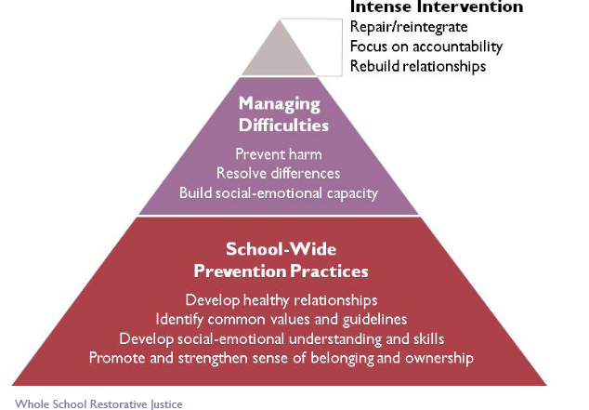
Restorative Practices
2013-2014 CPS OSEL Restorative Practice Guidelines

Slide 33
Alton High School
After school group to reduce out of school suspensions (OSS) for students with substance or physical aggression (Fall 2011) Resulted in 57% decrease in ODRs
At the end of 2011-12, 55 students had been referred to the four-session program. Only 37 completed the program (67%) and six of this group had repeated offenses
In 2012-13, in an effort to improve the process and impact, the school's coach incorporated restorative practices into the program
The more interactive format had students meet in a circle, discuss the harm caused, and the relationships impacted by their actions.
In 2012-13, 30 out of 41 referred students completed the program (73%), with only one student having a repeat offense.

Slide 34
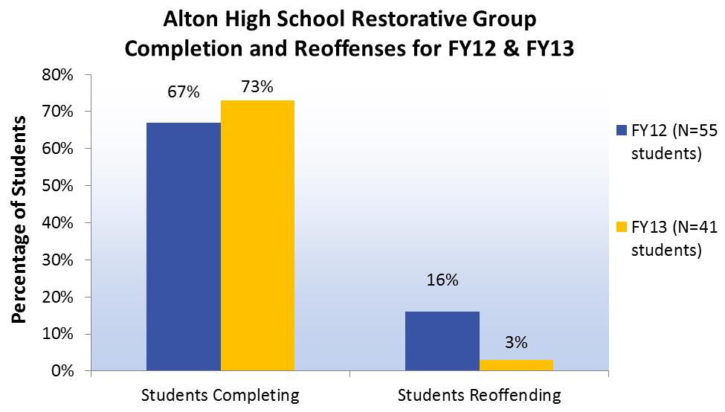
Alton HS Integration of Restorative Justice Enhances Tier 2 Supports
After-school group initiated to reduce OSSs for students with substance or physical aggression related discipline referrals
FY12 - 67% of students completed the program
FY13 - 73% of students completed program when enhanced by restorative practices
Notes:
Integration of Restorative Justice Enhances Tier 2 Supports in High School
In the fall of 2011, Alton High School in Alton CUSD 11 began an after-school group to reduce out of school suspensions (OSSs) for students with substance or physical aggression related discipline referrals. At the end of 2011-12, 55 students had been referred to the four-session program. Thirty-seven students completed the program (67%) and six of this group had repeated offenses. The following year, 2012-13, in an effort to improve the process and impact, the school's internal coach incorporated restorative practices into the program. The more interactive and restorative format had students meet in a circle, discuss the harm caused, and the relationships impacted by their actions. As a result, 30 out of 41 referred students completed the program in the 2012-13 school year (73%), with only one student having a repeat offense. The Restorative Justice practices added to the program in 2012-13 enhanced the engagement of students in the after school group, with increased positive behavioral outcomes outside of this group.

Slide 35
Mt. Carmel Middle School – Mt. Carmel, IL
Using the “repairing harm” principle to integrate restorative practices into SWPBIS
Problem-solving skills taught via targeted groups, with students identified by ODRs or staff/parent nomination
Skills and steps for problem-solving are defined, taught, modeled, practiced, acknowledged, and re-taught as needed
Groups also discuss the problem behavior that caused harm and focus dialogue around taking responsibility, listening to the victim, and repairing the harm done

Slide 36
Mt. Carmel Middle School Results
Groups were conducted in the fall and spring semesters of the 2012-13 school year
Resulted in 57% decrease in ODRs
By applying a response to intervention process, 2 students were identified as needing higher level intervention with more individualized features

Slide 37
Garden Hills School Champaign, IL Delores Lloyd, Principal Jill Johnson, Asst. Principal
Elementary Building in Champaign, Illinois
36% Latino, 33% Black, 11% White, bilingual, 87% poverty
Added 3 pieces to their PBIS framework to impact school climate:
Circle training for all staff
Restorative conversations
Trauma training for all staff

Slide 38

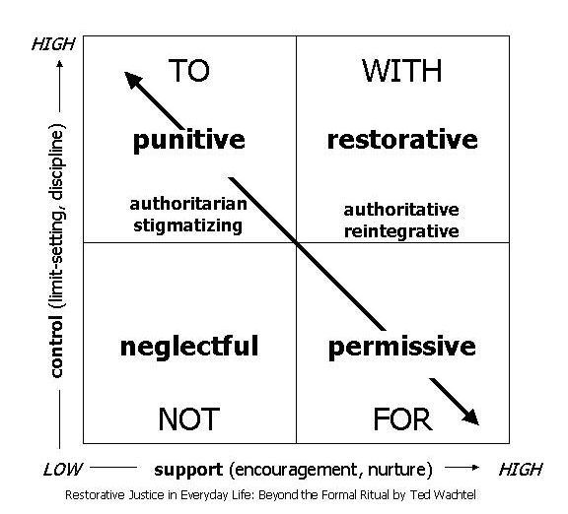
Social Discipline Window

Slide 39
Approaches to Discipline
Thorsborne & Blood, 2013
Retributive Justice | Restorative Justice
Blame and punishment; directives/orders Enquiry: What school/classroom/playground rule was broken? Who is to blame? What punishment/sanction is deserved? Approach – forms of punitive consequences/sanctions: removal from class, isolation from class, detention, writing of lines, not allowed to go on a field trip, group punishment, humiliation, suspension, exclusion, yelling, and the like Two broad hoped outcomes: 1.) inflict pain as a deterrent to the wrongdoer and others, and 2.) reduce reoffending | Relationships and restoring harm Enquiry: What happened? What has been harmed? How? What needs to happen to repair the harm? Approach: When wrong is done we work with those involved to help them take responsibility for their behavior by understanding how their actions affected others, learn from the incident and to take what action is required to repair the harm. Outcomes: 1.) student is still a valued member of the community, and 2.) all parties have equal space to tell their stories, be understood, and right wrongs

Slide 40
Five Characteristics
Of Restorative Practices
RELATIONSHIPS:
Developing caring connections and finding common ground
RESPECT:
Listening to others’ opinions and valuing them
RESPONSIBILITY:
Being accountable for actions taken
RESTORATION:
Repairing harm that has been caused
REINTEGRATION:
Ensuring all remain included and involved

Slide 41
Functions of Circle
Conflict
Resolution
Building
Community
Healing
Problem-
Solving
Brainstorming
Reflecting
Defusing
Tension
Social Skills
Welcoming
Farewell
Focus This School Year
Circles

Slide 42
Circle Basics
Circle components
Use of talking piece
The talking piece goes around the circle to each person
Students can choose to pass
Use of centering piece
Sit in circle
Establish your class values through Circle and link to 3 school-wide expectations
Starters: “What are you looking forward to this school year?” “What does an ideal school look like?” “What needs to happen in school for you to be comfortable?”
Link this conversation to values
Make your class values visible (posted, part of centering piece, etc.)

Slide 43
What That Means for You
Use of Circles daily
20 minutes, 8:45-9:05am daily
Note: SEL and PBIS Cool Tools will not start until the 4th week of school
SEL lessons and PBIS Cool Tools will be placed in your mailbox on Mondays
All staff & faculty participate in Circles from 8:45-9:05am
Choose a classroom to join, may vary each day
Monday | Tuesday | Wednesday | Thursday | Friday
Classroom Teacher | SEL Lesson | Classroom Teacher | PBIS Cool Tool | Classroom Teacher

Slide 44
Restorative Conversation
Tell me what happened.
What were you thinking at the time?
What do you think about it now?
Who did this affect?
What do you need to do about it?
How can we make sure this doesn’t happen again?
What can I do to help you?

Slide 45
What That Means for You
Restorative conversations should occur:
Preceding a office discipline referral
During the disciplinary process, by administration
Any time they would be helpful
Post restorative conversation questions
Link the restorative conversation to the class values, the needs of the other people or the impact of the student’s behavior on others
Read the questions as written, please do not deviate from the script
*This will be intentional work and will take time on the part of all staff

Slide 46
Let’s chat
Questions you have for Jill or Delores?
Other experiences or thoughts about how to think about Tier 1 integration with RP related to circles or restorative conversations?

Slide 47
What Should You We Do?

Slide 48
Phases of Implementation
Exploration
Installation
Initial Implementation
Full Implementation
Innovation
Sustainability
2 – 4 Years
Fixsen, Naoom, Blase, Friedman, & Wallace, 2005

Slide 49
Non Example of Alternatives to Suspension!
Notes:
Alternative to suspensions…the “Scarlet letter approach” …really????

Slide 50

The Restorative Chat: used by Administrators when processing suspensions with Students
Illinois Balanced and Restorative Justice
Tell me what happened.
What were you thinking at the time?
What do you think about it now?
Who did this affect?
What do you need to do about it?
How can we make sure this doesn’t happen again?
What can I do to help you?

Slide 51
IMPLICATIONS(MINKOS, LATHAM & SUGAI, 2014)
Underlying theoretical orientation and operational definition of school-based RJP needed to delineate what RJP is, what it looks like, how it is measured, what should be adopted, and how it should be considered in practice, policy, and research.

Slide 52
IMPLICATIONS(MINKOS, LATHAM & SUGAI, 2014)
Because little research has been conducted in schools and most research has been qualitative and conducted internationally, implementation of RJP in U.S. schools should be done with particular attention to relevance, fidelity, and student benefit.

Slide 53
IMPLICATIONS(MINKOS, LATHAM & SUGAI, 2014)
Rigorous quantitative research on behavioral outcomes conducted in U.S. schools is needed to determine whether RJP is an effective, efficient, and relevant intervention in a school setting, especially in relation to other evidence-based school practices

Slide 54
Questions raised about Restorative Practices
Requires a high level of verbal fluency to guide practices?
Practices not typical to teacher training?
Level of support and training needed?
Payoff for Instructional time ‘exchange’?
Can we document core features?
Can we measure fidelity and direct outcomes?

Slide 55
Cautions
RP being implemented piecemeal, or without systems / framework
Systems approach will:
Ensure practices are implemented as intended
Ensure consistency across the school
Ensure RP is not being used when contraindicated by function of a problem behavior
EX: Circles can be an opportunity to get uninterrupted attention.

Slide 56
Enhancements
RP has high social validity
Provides clear alternatives to suspension and exclusions
Classroom strategies
Administrative strategies
SWPBIS provides a framework for implementation and data-based decision-making

Slide 57
Needs
Create and validate fidelity measures for RP:
Define critical features
Are the critical features the same in every school?
Measure impact on:
Academic instructional time
Student problem behaviors
Peer interactions
Feelings of belonging
Adult responses to problem behavior
Suspensions, expulsions, and graduation rates

Slide 58
Dialogue: Share in chat
Any ideas for implementation?
Cautions for implementation?
Any additional questions?

Slide 59
As we close, respond in the poll box
What was your most important point your walking away with….

