Slide 1
Healing the harm:
The power of process and dialogue
A workshop with Margaret Thorsborne
IPBA conference, San Diego
2014

Slide 2
Workshop outcomes
Participants will:
Understand the differences between various philosophies/approaches to problem-solving around cases of bullying
Understand the nature of emotional harm and the behaviours that result from that harm
Understand how restorative approaches are more likely to help both those responsible and those harmed

Slide 3
Relational harm
At your tables and in 2 or 3’s, discuss a case of bullying you know and draw a sociogram of the web of relationships within the case
Who is in the story?
Indicate where the greatest damage has been done to these people and their relationships

Slide 4
What do those harmed need?
To tell what it has been like
To be understood
To understand why it happened
To be validated and have harm acknowledged
To know the person responsible is truly sorry
To be relieved of the burden of their shame
To be reconnected with their community of care
To be able to heal and let go (forgiveness?)

Slide 5
What do those responsible need?
A chance to be able to explain themselves
To be treated with respect
To be reconnected with their community of care
To be relieved of their burden of shame
To be able to participate in deciding what to do
To be able to heal and let go (redemption)

Slide 6
Retributive Justice | Restorative Justice
Crime and wrongdoing are violations against the laws/rules: What laws/rules have been broken? | Crime and wrongdoing is a violation of people and relationships: Who has been harmed? In what way?
Blame must be apportioned: Who did it? | Obligations must be recognized: Whose are these?
Punishment must be imposed: What do they deserve? | How can the harm be repaired?

Slide 7
Building Social Capital
High
TO
WITH
Punitive
Relational
cooperative
collaborative
problem solving
responsibility
authoritarian
stigmatising
Structure/Limits
Neglectful
Permissive
rescuing
excusing
reasoning
NOT
FOR
Low
Support
High
Blood, 2004 Adapted from Wachtel,T 1999.

Slide 8
DEMANDING
Cold and demanding
Warm and demanding
Cold and undemanding
Warm and undemanding
COLD
WARM
UNDEMANDING
Maurie Abraham, 2014

Slide 9
The Restorative Process
Those responsible tell the story about what they did
Everyone talks about what impact this has had on them
The group reaches a shared understanding of the harm that has been done
The group negotiates an agreement about how to repair the damage and minimise further harm

Slide 10
The restorative dialogue:
Person responsible
What happened?
What were you thinking when you did that?
What have you thought about since?
Who do you think has been affected?
In what way?

Slide 11
That “thinking” question
What was the purpose of that?
What were you hoping would happen?
What were you expecting would happen?
What was going on in your head when you did that?
What made you decide to do that?

Slide 12
The restorative dialogue:
Person harmed
What did you think when it happened?
What have you thought about since?
How has this affected you?
How did your family/friends/colleagues react when they heard?
What has been the worst of it for you?

Slide 13
The restorative dialogue:
Victim supporters
What did you think when you heard?
How do you feel about what has happened?
What has happened since?
What changes have you seen in ……….
What are the main issues for you?
What has been the hardest for you?

Slide 14
The restorative dialogue:
Wrongdoer supporters
What did you think when you heard?
What have you thought about since?
How has this affected you?
How are things between you all in the wake of this?
What has been the worst of it for you?

Slide 15
Regarding those harmed
What do they FEEL?
What do they THINK about Self and Others?
What do they DO (ie what behaviors would we see)?
If we are to intervene, what outcomes do we want the intervention to achieve?

Slide 16
Biology of Emotion
Affect system
Consists of motor and sensory innervations in and out, effector organs carrying out responses and no specific place in CNS
9 pre-wired, innate reflexive responses to incoming stimuli
Each of the 9 programs includes a specific facial response as a signal to self and others about the nature of the triggering stimulus

Slide 17
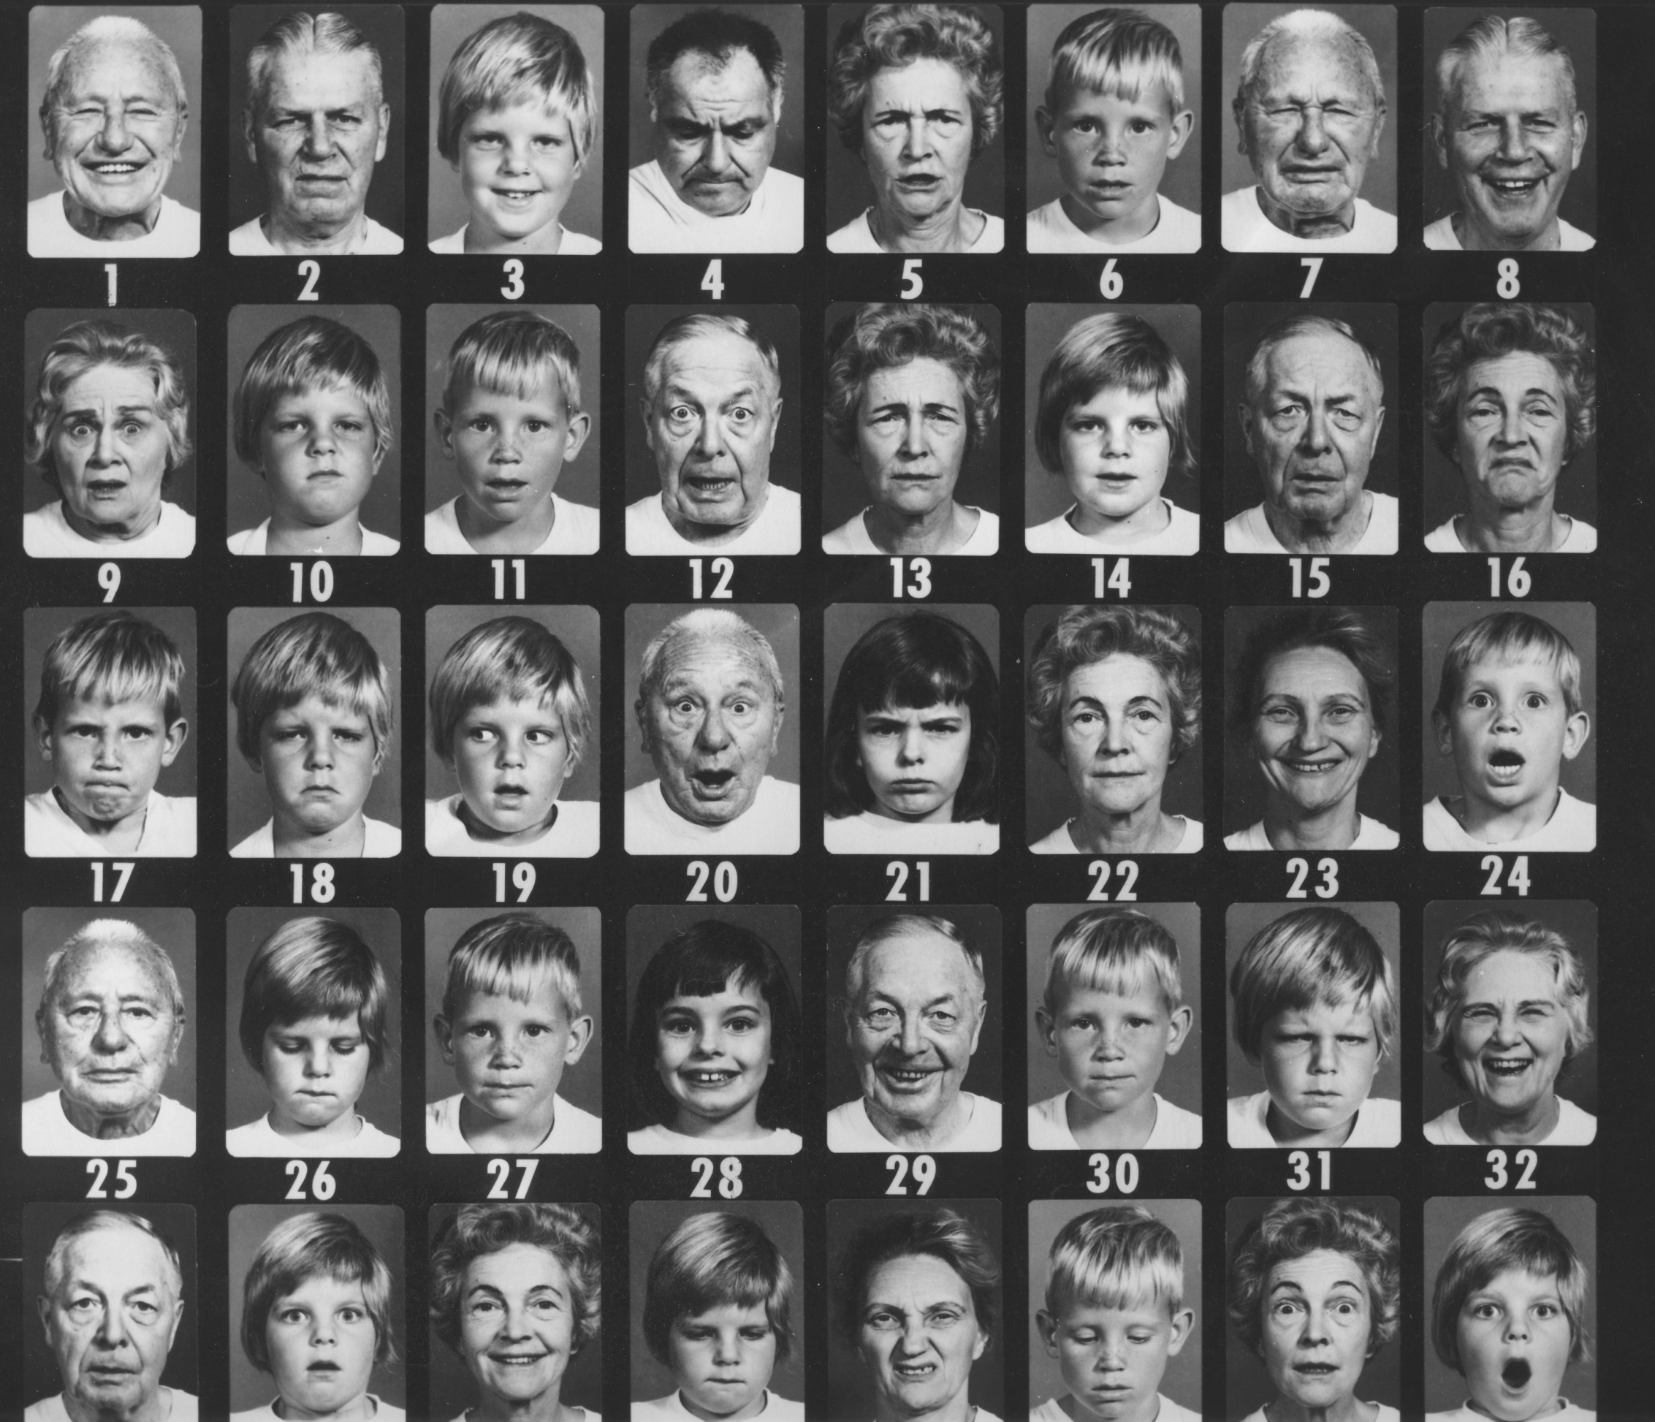

Slide 18
Affects come in three flavors
Neutral: system reset
Positive: rewarding, we want more
Negative: punishing, we want it to stop

Slide 19
Affects
  Positive
  INTEREST-EXCITEMENT
  ENJOYMENT-JOY
  Negative
  FEAR-TERROR
  DISTRESS-ANGUISH
  ANGER-RAGE
  DISGUST
  DISSMELL
  SHAME-HUMILIATION
  Neutral
SURPRISE-STARTLE

Slide 20
Affect and motivation
Affect | Motivation
Interest | Engage
Enjoyment | Affiliate
Surprise | Stop. Look. Listen
Shame | Seek to restore
Distress (sadness) | Comfort
Anger | Attack
Fear | Run
Disgust | Reject after sampling (get rid of)
Dissmell | Reject before sampling (stay away)
Abramson, 2013

Slide 21
The Affect System
Because nothing reaches consciousness unless an affect is triggered first, the affect system is the primary motivational system for all forms of human behavior.
Said another way: all behavior is preceded by an affect or emotion. To understand any behavior, one must understand the emotion that motivates it.

Slide 22
Partial list of shame-based emotions
Ashamed of the self
Hurt feelings
Feeling Abandoned or Rejected
Feeling Distant from others
Feelings of Loneliness
Shyness
Feeling Exposed
Frustration
Feeling Disappointed.
Having a sense of Helplessness or Despair.
Feeling Discriminated against and Disrespected.
Feeling Weak, Incompetent and like a Loser.
Feeling Guilty about something I did that made me look lesser in the eyes of others and myself.

Slide 23
The Central Blueprint
Directs all behavior and thinking to:
Maximize Positive Affect
Minimize Negative Affect
Minimize the Inhibition of affect
4. Maximize the power to do 1-3

Slide 24
Interpersonal & Group Dynamics
Central blueprint and Affective Resonance lead groups to:
Mutualize and maximize Positive Affect
Mutualize and minimize Negative Affect
Mutualize and minimize the Inhibition of affect
4. Mutualize and maximize the power to do 1-3

Slide 25
The Central Blueprint
Mental and emotional health of individuals, couples, families, and communities is maintained when the four rules of the Central Blueprint are followed with a balanced pattern of rules 1-3.
Situations that force the rules to be violated in any way produce harm because they are in conflict with the innate wiring in our CNS.

Slide 26
What is Emotional Harm?
Presence of persistent or unrelenting negative affect (especially fear, distress, shame, or anger) when:
  a) the negative stimulus persists or
  b) a mood state has been activated or
    c) both.
Chronic distortion in the rules of the Central Blueprint as a means of compensation.

Slide 27
What is the effect of Harm?
Persistent negative affect and moods:
reduce positive affect so that interest and enjoyment of life diminish because they become more difficult to trigger.
increase disease risk including depression, suicide, hypertension, heart attack, gastric ulcer, etc.
reduce one’s ability to concentrate or care about work or school (things that require interest).
impede interpersonal connections triggering shame in relationships.
Kelly, 2014

Slide 28
What is the effect of Harm?
Distortion of Central Blueprint rules:
Maximize positive: can become impossible or can become excessive pleasure seeking to the exclusion of life’s realities.
Minimize negative: can become impossible creating a withdrawn, avoidant, even paranoid life style.
Minimize inhibition: can become the opposite, reducing awareness of self and ability to connect with others.
Maximize power: can become impossible freezing the ability to grow and develop new personality strengths.
Kelly, 2014

Slide 29
The effect of Harm
When harm causes shame (as it almost always does), it usually creates further harm. Shame is triggered by any impediment to positive affect BUT once triggered it also acts as a further impediment.
The extreme end product of this process is TOXIC SHAME that completely isolates people from self, friends, family, and community.
Traditional methods of punishment for misdeeds and crimes (especially prisons) increase shame in both perpetrator and victim alike making toxic shame outcomes more likely.
Kelly, 2014

Slide 30
Defensive Responses to Shame
How do people respond when shame is triggered and the information shame provides cannot be used to constructively remove the impediment ?

Slide 31
Defending against shame
ATTACK OTHER
WITHDRAWAL
AVOIDANCE
ATTACK SELF
Nathanson, 1992

Slide 32
QUASI - NORMAL | TOXIC
WITHDRAWAL Shyness, solo activities | Agoraphobia, rejecting human contact
AVOIDANCE (denial) Toughie, workaholic, substance use | Super macho, addictions, failing to take responsibility, lying
ATTACK SELF Self put downs (internal and stated) | Masochism, self-mutilation, suicide
ATTACK OTHER Angry put downs, sarcasm | Revenge, retribution, punishment, murder, violence, bullying
Withdrawal
Quasi Normal | Toxic
Adapted from Kelly, 2007

Slide 33
How can restorative processes help?
Central blueprint rules:
Coming together to tell the stories about the incident(s) (mutualising the expression of affect – rule 3)
Listening carefully (with increasing understanding and acknowledgement) to the harm (mutualising and minimising –ve affect – rule 2)
Making plans for the future and reconnecting of relationships (mutualising and maximising +ve affect)

Slide 34
Trauma Informed Principles (TIP)
Physical and emotional safety
Trustworthiness
Communication
Choice
Control
Consent
Collaboration
Empowerment
Victims Services NSW
Notes:
Safety, both physical and psychological, is core to this process and must be informed by an understanding that many trauma survivors struggle to feel safe. Of people
presenting to Victims Services, some have never felt safe, in their bodies, relationships and/or homes. Services need to be safe havens, which prioritise each client’s understanding of safety, rather than that determined
by the service.
Because repeated experiences of betrayal are common in the lives of those impacted by crime, trust often builds slowly. In services, trust is facilitated through
the sharing of power, information and mutually agreed boundaries. The dynamics of power must be not only recognised and acknowledged but actively addressed, as abuse of power may continue to characterise current intimate relationships.
Many people remain in chaotic and unpredictable relationships and feel out of control in the present, as well as the past. They often present at their most distressed and vulnerable, and are easily triggered and struggle
to regulate their emotions. Predictability and a sense of control, through choice and collaboration, enable them to better manage their emotional highs and lows. The experience of relationships registers in the brain

Slide 35
Challenges for Practitioners
Understanding & identifying trauma needs
Preventing re-traumatising practices
Avoiding reproducing dynamics of victimisation
Offender focused justice systems
Institutional re-traumatisation
“Just a witness”
Managing expectations
Effective communication
Giving choices
Victims Services NSW

Slide 36
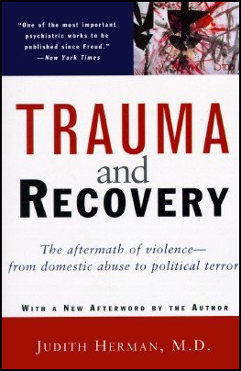
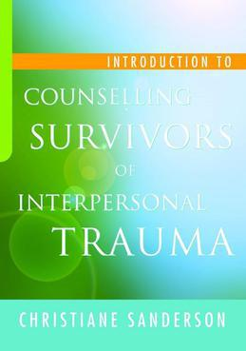

Slide 37



Margaret Thorsborne
Email: marg@thorsborne.com.au
Web: www.thorsborne.com.au
Mobile: +61 412 135 015
@ThorsborneMarg
Marg Thorsborne
Margaret Thorsborne and Associates

