Slide 1
A Coming Revolution in CEQA and Sustainable Community Planning: What School Districts Need to Know
Dwayne Mears
The Planning Center|DC&E
Orange County Department of Education
June 13, 2012

Slide 2
Initial Observations
We haven’t seen this much CEQA action – legislatively or by the courts in a long time
Legislative action tends to come during recessions – a call to “streamline” CEQA
Development and business interests believe CEQA is too cumbersome and hurts the California economy
Many believe it could be improved
Previous streamlining efforts have failed, but maybe this time?

Slide 3
We’re Going to Cover
CEQA Streamlining under SB226 (for infill projects)
Could be some real benefits for school districts (save time/money, more than current other streamlining approaches)
SB375 and coming Sustainable Communities Strategy Plans
Additional CEQA streamlining opportunities
Growth patterns will change and schools could be impacted in multiple ways

Slide 4
AB 226: CEQA Streamlining for Infill Projects

Slide 5
Draft Guidelines – The Basics
SB226 adopted in 2011, amended CEQA, & requires development of revised implementing Guidelines for new infill streamlining
Final Guidelines must be adopted by 1/1/2013
Also need SCS or APS adopted by MPO for use by LEAs
Other SB226 sections are now in effect for solar project exemptions

Slide 6
Infill Projects Defined
Consists of any one or combination of:
1. Residential
2. Retail or com’l with no more than ½ area in parking
3. Transit station
4. School
5. Public office building
And located in an “Urban Area” and site previously developed (substantial portion mechanically altered for zoning allowed use), or if vacant 75% of site’s perimeter adjoins developed urban land uses

Slide 7
“Urban Area” Defined
“Urban Area”
Incorporated city
Unincorporated area that meets both:
Population of unincorporated area and surrounding incorporated cities of 100k or more,
and
Population density of unincorporated area equal to or greater than incorporated cities.

Slide 8
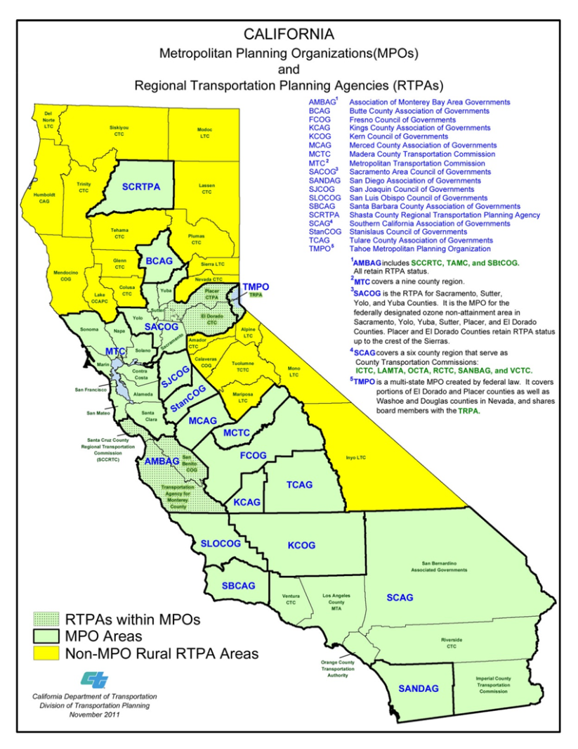
Qualifying for Exemption
Satisfy any of:
1. Consistent with SCS/APS
2. Small Walkable Community Project
(not applicable to schools)
3. Located in MPO before SCS/APS adopted
(not applicable to schools)
And satisfy all applicable statewide
performance standards

Slide 9
Proposed CEQA Guidelines – Performance Standards
Eligibility Standards for Infill Projects, each must have:
1. On-site Renewable Energy for non-residential projects (where feasible)
Soil and Water Remediation
Sites on Gov. Code Section 65962.5 Cortese list must document how remediated or that PEA recommendations will be implemented as part of project
Residential Units near High-volume Roadways and Stationary (doesn’t apply to schools)

Slide 10
Proposed CEQA Guidelines – Performance Standards
Additional Eligibility Standards for Schools
1. Elementary Schools
Located within 1 mile of 50% of projected student population
2. Middle and High Schools
Located within 2 miles of 50% of projected student population
OR
3. School is located within ½-mile of existing major transit stop or high quality transit corridor with bus service every 15 minutes

Slide 11
Proposed CEQA Guidelines – Performance Standards
Additional Eligibility Standards for Schools (con’t)
Schools must provide parking/storage for bikes/scooters
Must comply with Ed. Code Sections 17213, 17213.1 and 17213.2 (nothing new here for state-funded schools)

Slide 12
New Checklist for “Infill Projects”

Slide 13
New Checklist for “Infill Projects”
Prior Plan-Level EIR
Was school project’s effects addressed in EIR?
Are effects more significant than in EIR?
Exempt if answers are 1: yes; 2: no
Even where effect not addressed or addressed but more significant:
Exemption possible if uniformly applicable development standards/policies would “substantially mitigate” effect

Slide 14
Streamlined “Infill EIR”
If EIR required for Infill Projects, streamlining still available:
Focus on new issues
EIR need not review alternative locations, densities or building intensities
2. EIR need not review growth inducing impacts

Slide 15
Some Questions
How is consistency with SCS determined?
If school is allowed use in GP/Zone?
Guidelines specify use, density, building intensity, policies
But many school buildings exceed height limits
No minimum size required of renewable energy?
How is “where feasible” defined in this context?
Compliance with ECS 17213 (part B for ¼ mile and 500 feet findings even if not preparing a ND or EIR?)
Compliance with ECS 17213.1&2 (require DTSC even if not state funded?)

Slide 16
Some Questions (con’t)
How to measure projected “student population”
Within attendance area? (official attendance boundaries are often not established until after CEQA process is complete)
What about charters, magnets without boundaries?
New schools are often phased. Is it based on opening, ultimate buildout, or other projected enrollment?
How is distance measured?
“Pedestrian miles” was deleted; now as crow flies from perimeter?
What if K-8, K-12? Prorate distances?
Suggested Appendix N: “attach map and methodology”
Bikes & scooters parking & storage?
Both bikes and scooters? What about skateboards?
What capacity? What constitutes storage?

Slide 17
What to Do Now
Review general plan/zone designations of school sites
Look for consistency with use, density, building intensity, policies
Monitor updates to your city’s general plan – seek to build consistency
Determine if school sites were previously exempted from local zoning

Slide 18
What to Do Now (con’t)
Consider creating “uniformly applicable development policies or standards”
Check with your city to see if you can benefit from their efforts
Work with C.A.S.H. to develop a model set of standards?

Slide 19
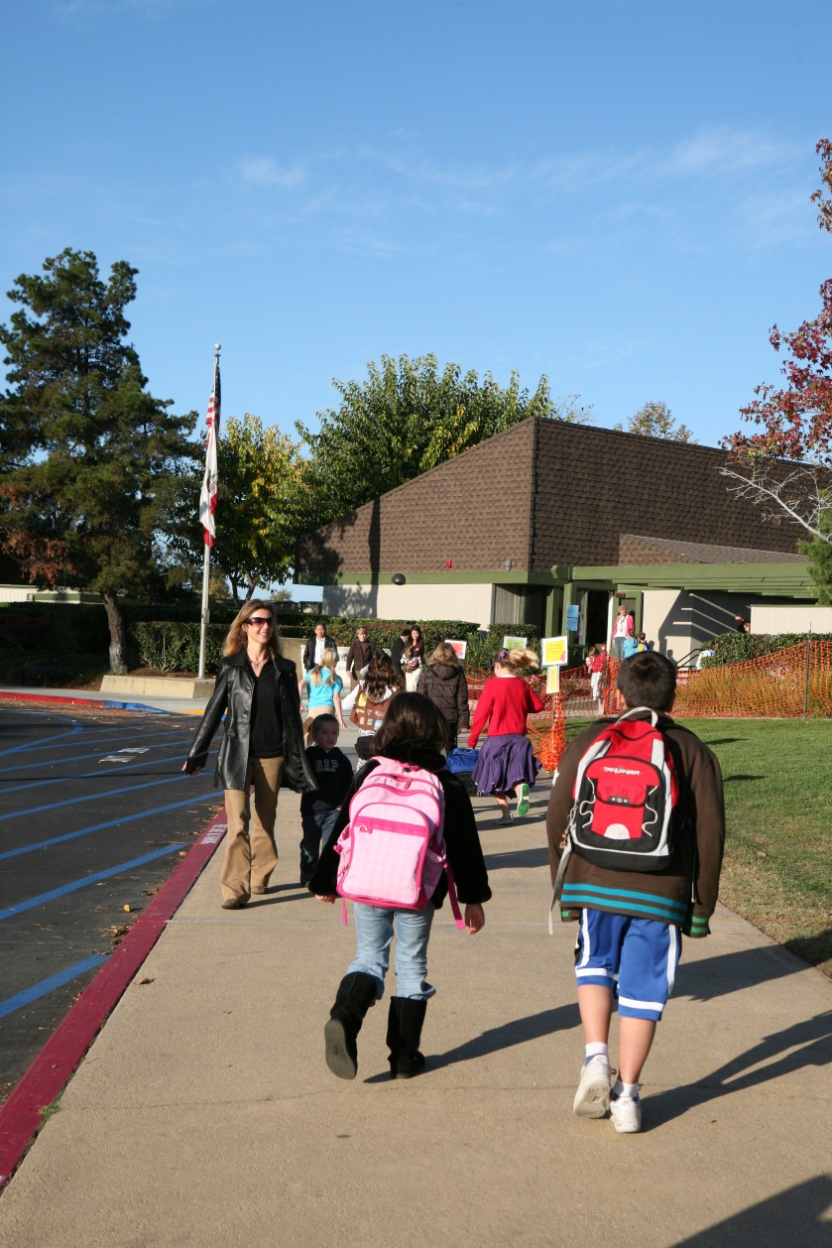
Orange County’s Sustainable Communities Strategy
Orange County SCS Adopted June 2012 by OCTA and OCCOG and SCAG incorporated OC SCS into Draft 2012 Regional RTP/SCS
Goal is reduction of GHGs from cars and light trucks to achieve targets set by Air Resources Board for 2020 & 2035
SB375 established incentives for compliance (transportation funding and CEQA streamlining for consistent infill projects)
SCS implementation is primarily up to city/county planning/zoning

Slide 20
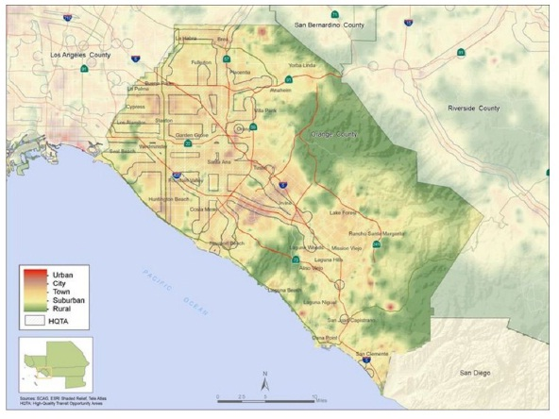
Orange County

Slide 21
Orange County’s SCS
Does the SCS land use /transit strategy put existing or future schools at risk?
New transit facilities/or increased use of traffic corridors near schools and resulting hazards/exposures
Regional benefits (GHG reduction) vs. local impacts (air toxics)?
Greater competition for land? Higher costs, greater difficulty in finding land for schools in urban areas?
Increased opposition from industry (restrictions in use/expansion) and cities (revenue concerns)

Slide 22
What About Streamlining under SB375?
SB375 also allows certain qualifying projects to be exempt from CEQA, or to use streamlined documents (limited SC Environmental Assessment or EIR
School might qualify as part of:
- Transit Priority Projects (TPP):
-at least 50% residential, at least 20 units/acre
-within ½ mile of major transit stop/corridor
-no more than 8 acres, 200 residential units
Mixed Use Project
-at least 75% residential or a TPP
Our opinion: the req’ts to qualify aren’t worth the effort

Slide 23
Coming Revolution in CEQA & Sustainable
Community Planning
Contact Info
The Planning Center|DC&E
Dwayne Mears, dmears@planningcenter.com
714.966.9220
More info on SB226: ceres.ca.gov/guidelines-sb226/

Slide 24
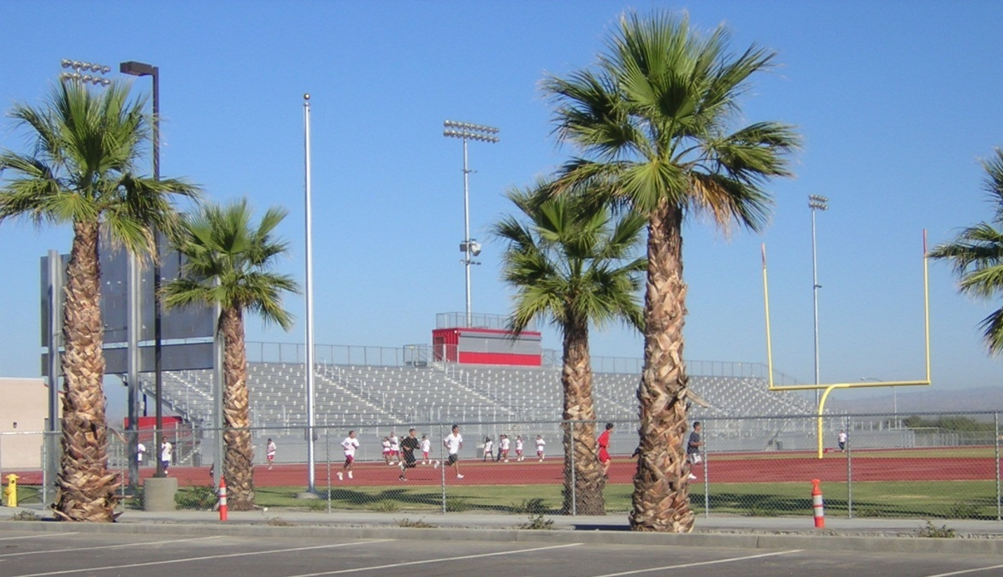
Questions and Comments

Slide 25
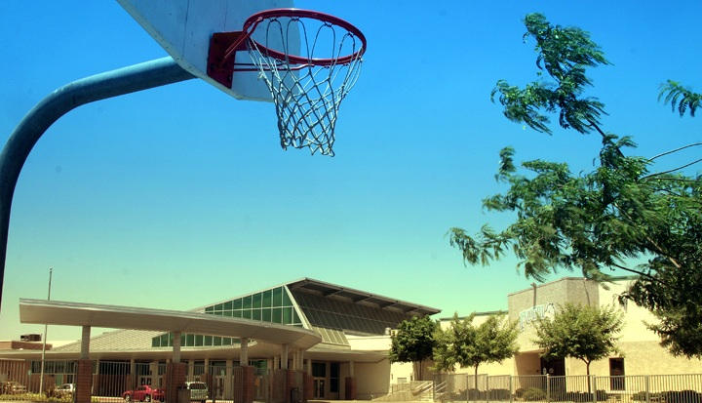
Conflicting Case Law on CEQA Baseline
Sunnyvale I and II, Neighbors for Smart Rail

Slide 26
CASE LAW
Sunnyvale West Neighborhood v. City of Sunnyvale, 2011
EIR violated CEQA by comparing traffic conditions in 2010 against hypothetical 2020 baseline
Many traffic studies have violated this concept:
Projects take years to complete, so there’s reason to look into to future
Forecast future road improvements & other changes and include in baseline
Completion of such improvements is uncertain and reduces ability to discern real impacts
Court rejected this often-used approach

Slide 27
Conflicting Case Law on CEQA Baseline
Neighbors for Smart Rail v. Exposition Metroline Construction Authority
“use of projected conditions may be an appropriate way to measure … traffic, air quality and greenhouse gas emissions”
Distinguished from CBE v. SCAQMD: future baselines based on substantial evidence are not “illusory”
Key: demonstrate “reliability of the projections and the inevitability of the changes on which those projections are based”

Slide 28
Conflicting Case Law on CEQA Baseline
How to proceed with these two conflicting cases?
We recommend including both scenarios where appropriate
Existing conditions
Add future projections scenario where you can demonstrate the “reliability of the projections and the inevitability of the changes on which those projections are based”
This issue is often raised for new schools in undeveloped areas: what road network should be included?

Slide 29
Conflicting Case Law on CEQA Baseline
Communities for a Better Env. v. SCAQMD
Court ruled refinery’s maximum permitted capacity could not be used as its baseline
What about a school’s unused but existing capacity?
CBE case suggests the key is whether the capacity was subject to previous CEQA review

Slide 30
Conflicting Case Law on CEQA Baseline
Communities for a Better Env. v. SCAQMD
If you can find supporting CEQA review, use capacity
If you can’t, better to use enrollment or be prepared to document “nonnormal” conditions:
Where enrollments have fluctuated, use average to even out the dips and spikes
Or previous year that you can document better reflects the future condition

Slide 31
CEQA Baseline Cases and Class 14 Exemptions
Impact on CEQA categorical exemption Class 14?
Additions to existing schools, within existing school grounds, up to 25% increase in “original student capacity” (OSC) or 10 classrooms, which ever is less
Multiple definitions of OSC:
When school was built
Last CEQA review
When CEQA was enacted
When current project was proposed
Do these recent baseline cases provide some clarity on this issue?

Slide 32
CEQA Baseline Cases and Class 14 Exemptions
Most conservative to use existing enrollment (adjust for fluctuations as justified), or:
If appropriate, determine capacity at original construction, or at CEQA enactment
Add any capacity previously approved and CEQA reviewed
Compare proposed project against baseline to determine if exemption could apply
Also consider:
CEQA Exceptions to using exemptions: “if cumulative impact of successive projects of the same type in same place over time is significant”
GHGs shall not in and of themselves be deemed to cause an exemption to be inapplicable if project complies with SB226

Slide 33
CEQA: Impacts on the Environment
Ballona Wetlands v. City of Los Angeles
Court rejects notion that CEQA is an all-purpose public health statute
CEQA is focused on impacts on the environment, not the reverse
What about environmental hazards on school facilities? (CEQA checklist covers several hazards related to impacts on project and its occupants)
Some developers may push to eliminate such impacts from CEQA documents
Ed Code, etc. require review of hazards
Why not maintain public review of these issues within CEQA ?

