Slide 1
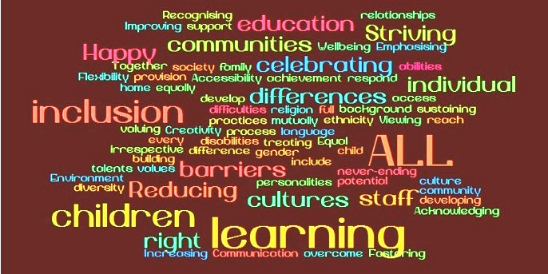
Executing the Grand Vision: Creating Driven Effective Learners
Inclusive Practices and Co-Teaching

Slide 2
Who We Are
Jennifer Ellerman and Janelle Mercado co-taught 7th Grade ELA in Sac City Unified School District for several years.
Debra Herburger co-taught with different special ed teachers over the course of several years.

Slide 3
https://todaysmeet.com/OrangeCountyCo-Teaching Make the change from audience member to active and learning participant!

Slide 4
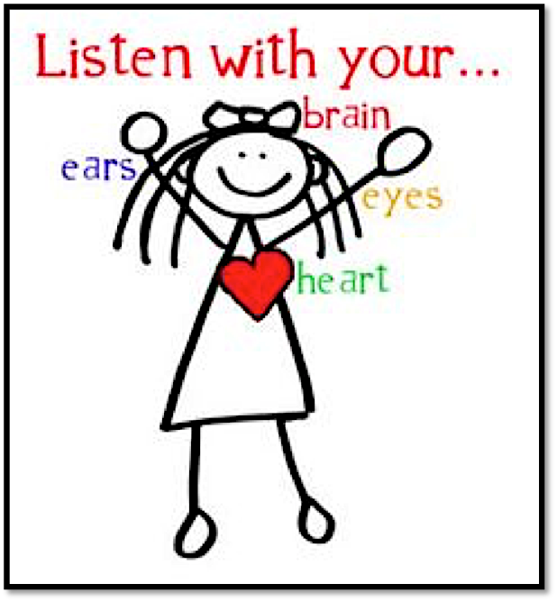

Slide 5
EVERYONE STAND UP!
Sit down if you are currently or will be co-teaching soon.
Sit down if you have co-taught in the past.
Sit down if you support others who co-teach.
Sit down if you are considering co-teaching for the future.
Sit down if you love working with children.

Slide 6
Big Ideas
Inclusion as a way of thinking;
Co-teaching Instructional Models;
Building a relationship through collaboration;
Tips to co-teach with success.

Slide 7
Changing the world is often seeing the familiar, but in a completely new way.

Slide 8
Changing the world is often seeing the familiar, but in a completely new way.

Slide 9
Changing the world is often seeing the familiar, but in a completely new way.

Slide 10
Inclusive
Pedagogy
Practices
Notes:
Janelle and Debra

Slide 11
Instruction in a Separate Setting (Special Day Class/ Self- Contained Class) | “Pull-Out” Support | Homogeneous Intervention Class | Co-Teaching | “Push-In” Support | Consultation
Although the goal in an inclusive school is for most instruction to occur in general education settings, occasionally student needs indicate this may not be the most appropriate and must be decided by the IEP team. | Special Ed ‘pull out’ at varying levels; for example, pull out twice a week for language/ speech therapy; pull out every day for a significant period of time. The frequency and duration of being pulled out will directly affect LRE. | A homogeneous class of all SWDs, taught by a special ed or gen ed teacher; limited interaction with non-disabled peers; possibly could lead to lower expectations of students, both academically and behaviorally; often starts out as an intervention class, can become remediation. | A mix of students with and without disabilities in the same gen ed class where the gen ed and special ed teachers work collaboratively to meet the diverse academic and social/behavioral needs of all students; both teachers PLAN, INSTRUCT, and ASSESS all students. | When the support for the student is brought into the gen ed class; may occur daily, weekly, or monthly. | Monitoring Support is often indirect, rather than direct, support; a professional with specific expertise, such as the speech-language therapist and special education teacher, work together to identify student needs, develop an intervention, and monitor the effectiveness of the intervention.

Slide 12
Instruction in a Separate Setting (Special Day Class/ Self- Contained Class) | “Pull-Out” Support | Homogeneous Intervention Class | Co-Teaching | “Push-In” Support | Consultation
Although the goal in an inclusive school is for most instruction to occur in general education settings, occasionally student needs indicate this may not be the most appropriate and must be decided by the IEP team. | Special Ed ‘pull out’ at varying levels; for example, pull out twice a week for language/ speech therapy; pull out every day for a significant period of time. The frequency and duration of being pulled out will directly affect LRE. | A homogeneous class of all SWDs, taught by a special ed or gen ed teacher; limited interaction with non-disabled peers; possibly could lead to lower expectations of students, both academically and behaviorally; often starts out as an intervention class, can become remediation. | A mix of students with and without disabilities in the same gen ed class where the gen ed and special ed teachers work collaboratively to meet the diverse academic and social/behavioral needs of all students; both teachers PLAN, INSTRUCT, and ASSESS all students. | When the support for the student is brought into the gen ed class; may occur daily, weekly, or monthly. | Monitoring Support is often indirect, rather than direct, support; a professional with specific expertise, such as the speech-language therapist and special education teacher, work together to identify student needs, develop an intervention, and monitor the effectiveness of the intervention.
INSTRUCTION (high-quality instruction is essential in every setting along the continuum)
Universal design for learning (UDL) is a framework to improve and optimize teaching and learning for all learners based on scientific insights into how humans learn; UDL is the proactive design of curriculum and instruction to ensure they are educationally accessible regardless of learning style, physical or sensory abilities.
Research-based, high-quality, general instruction and support for all learners;
Assessment for learning;
Scaffolding (providing each student the level of support needed to access learning in his/her Zone of Proximal Development).
“In order to participate with success in the general curriculum, students with disabilities, as appropriate, may be provided additional supports and services, such as, instructional supports for learning based on the principles of Universal Design for Learning (UDL) which foster student engagement by presenting information in multiple ways and allowing for diverse avenues of action and expression” (Applications to Students with Disabilities, Common Core State Standards).

Slide 13
Co Teaching
When two or more educators CO-PLAN, CO-INSTRUCT, AND CO-ASSESS a group of students with diverse needs in the same general education classroom (Murawski, 2003).

Slide 14
Qualities of Effective Co-teaching
“The two teachers delivering content to the class have equivalent licensure or status and participate fully in the instructional process. In other words, both teachers work with ALL students.”
--Marilyn Friend

Slide 15
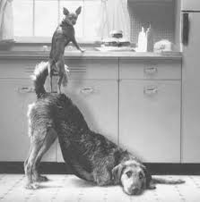
The lens you should always look through
How is what the two of you are doing together substantively different and better for students than what each of you could do alone?
Notes:
The lens through which you should plan and deliver ever co-taught lesson.
Do you or your colleagues divide students in your conversations, referring to “my students” or “your students?” Whenever this happens, you are reinforcing an antiquated “separate” system, one that communicates learners with special needs are the responsibility of the special educators/specialists, not general educators. It is important to remember that special education and other related services were designed to supplement or be added to in addition, not in lieu, of general education. Thus, general education teachers are charged with teaching every student in the class, including those with disabilities, and they are as accountable for their learning just as they are accountable for the students that do not have identified disabilities/those in general education.
Co-teaching is very much about OUR students1

Slide 16
Instructional Models for Co-Teaching
There are several instructional models for co-teaching—different structures that serve different purposes.
You will not use any one model all of the time—it will depend on the goals and objectives of the lesson and how you are structuring student interaction for that particular lesson.

Slide 17
Instructional Models for Co-Teaching
Do you EVER stick to one single instructional model for the entire period of instruction, or do you use a variety of models, such as shorter lengths of direct instruction (lecture) interspersed with hands-on application and practice?

Slide 18
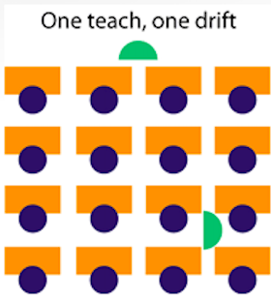
Lead and Support (aka one teach, one assist/ one teach, one drift)
In this structure one teacher leads and the other teacher offers assistance to individual students or small groups.
Click the icon to view the video

Slide 19
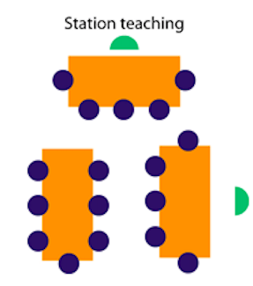
Station Teaching
Teachers divide instructional content into several segments and present the content in separate stations around the classroom.
With two stations, the General Educator and Special Educator each teach their portion of the content and then switch groups. Alternatively, both teachers may move between groups in order to provide support.
If students are able to work independently with content, a third station may be established.
Click the icon to view the video

Slide 20
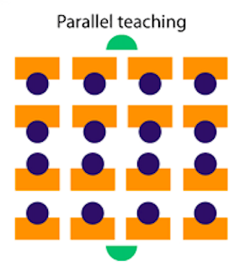
Parallel Teaching
General Educator and Special Educator plan instruction jointly, but each delivers instruction on the same content to a heterogeneous group consisting of approximately half the class.
Click the icon to view the video

Slide 21
Alternative Teaching
One teacher works with a small group while the other teacher interacts with the larger group.
Small groups can be pulled for pre-teaching, re-teaching, enrichment, interest groups, special projects, make-up work or assessment groups.
Click the icon to view the video

Slide 22
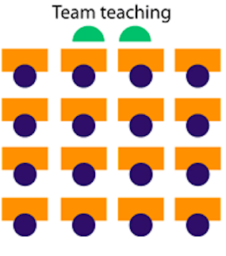
Team Teaching
Both teachers share in the planning and instruction of all students in a highly coordinated fashion .
Both teachers must have equality in content knowledge and teaching ability, and common planning time.
Click the icon to view the video

Slide 23
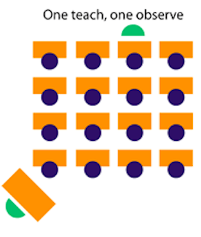
One Teach, One Observe
In this structure, one teacher takes the instructional lead while the other teacher is observing students or a specific students for a clarified purpose, gathering data, identifying student needs, observing student learning patters, etc.
The observing teacher will share his/her observations with the instructional lead teacher and together they will make decisions based on the observations.

Slide 24
Common Characteristics of an Entire Lesson
Both teachers have presence in their role
A climate of success for all students is created - with both teachers focusing on ALL
Progress is monitored and learning assessed daily
Academic and social skills are taught
Objectives are clear
Engaged learning time is maximized
Differentiation is expected by both teachers
Lisa Dieker

Slide 25
Elements to consider when choosing an instructional model
Lesson objectives and learning outcomes
Student needs
Make up of the class
Available resources
Educator expertise
Each co-teacher’s comfort level with content
Purposeful student grouping
Opportunities to take advantage of having two educators
Notes:
25
Students needs are considered in relation to curriculum objectives. If the lesson requires the student to respond and demonstrate understanding, then the collaboration model and instructional accommodations reflect what instructional supports the student needs to achieve the lesson objectives.

Slide 26
What Do You Bring to the Co-Teaching Relationship?
Think about the knowledge, skills and characteristics you bring to the partnership. In what ways are you and your teaching partner/collaborator similar?
How might your similarities contribute to the effectiveness of your lesson planning? How might they detract from it?
In what ways are you and your teaching partner different?
How might your differences contribute to the effectiveness of your lesson planning? How might they detract from it?
How might you and your teaching partner work together to incorporate shared lesson planning responsibilities?

Slide 27
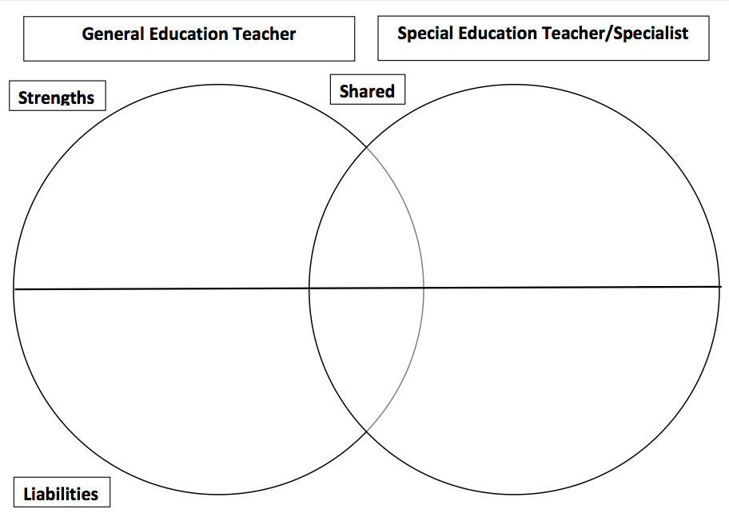

Slide 28
Building a relationship
Prerequisites
Role Reciprocity
Shared Philosophy
Collaboration
co-planning
Face to face planning
Electronic planning
On the spot planning
Notes:
Prerequisites
1. Personal Prerequisites- co-teachers should have personal characteristics/qualities that are supportive of working with others. They should have the ability and willingness to set aside differences, be flexible and surrender control.
2. Professionalism Prerequisite- co-teachers need to both understand school, teaching, and students and have a clear understanding of how to conduct themselves in a professional manner within the culture of the school. For example, a teacher needs to know how to be a mentor to a student rather than act as a friend to them.
3. Discipline-specific prerequisites- co-teachers must possess expertise within their area of specialty in order to justify a reason for their partnership. For example,
Role Reciprocity: This is the process of exchanging expertise amongst co-teachers with the intention of benefiting their teaching and learning amongst students.
General education teachers have these four areas of primary expertise:
1. Curriculum and instruction- knowledge of what needs to be taught, in what order, and how the content fits in the big picture within the curriculum
2. Classroom Management- because general education teachers have large class sizes, they must be skilled at getting all of the students to behave, focused, and engaged in learning.
3. Knowledge of typical students- good sense of whether student learning or social/behavioral functioning is within the parameters of what they expect
4. pacing- general education teachers are skilled at knowing how to move through curriculum and address all of the standards.
Specialists have these four areas of expertise:
1. Process of learning- teaching students how to learn. They are skilled at providing students with strategies, accommodations, modifications, language instruction, or other interventions that will facilitate learning.
2. Individualization- Trained to focus on the individual needs of students and to ensure that that particular student is getting what they need to learn.
3. Documentation and other accountability paperwork- although all teachers complete paperwork, the greatest burden placed on specialists is the extensive amount of paperwork, data and documentation required by law.
4. Emphasis on mastery versus coverage, with pacing and a secondary consideration- focus on assisting students in mastering a specific concept or skill.
* co-teachers often refer to their instruction in a way that they “cant be seen apart from one another.” If this is the case because they have strong co- teaching skills and are both engaged in the instruction, that is fabulous. However, co-teachers should not be interchangeable. Each has a different skill set that should be contributed to create more successful outcomes then would have been had only one of the two been providing instruction independently.
Shared Philosophy: co-teachers lead a classroom family, which is why co-teachers often refer to their relationship as a co-teacher marriage. This is extremely accurate, in that co-teachers jointly establish their own shared vision, culture, roles and responsibilities within the classroom. They share successes and together solve problems that occur.
Collaboration: it is a style for interaction based on mutual goals, parity, voluntariness, shared responsibilities, shared accountability for outcomes, and shared resources (Friend and Cook, 2013). Trust and respect in the sense of a classroom community is needed.
Co-Planning: It is important that co-teachers have time allotted to them for co-planning to discuss their instruction and their students. However, shared planning time continues to be a struggle for many. Therefore, Dr. Friend suggests a three part model and a new way of thinking about planning.
Face-to-face planning- this can be done through a shared prep. period, finding coverage to allow for face-to-face planning (weekly/monthly). Other examples are summer planning, compensated after school planning, use of a substitute teacher, teacher development days, coverage by a teacher within related arts
Electronic Planning- use of electronic planning to compliment face-to-face planning. This can be done via e-mail, shared calendar, shared wiki space, google docs.
On the Spot Planning- CAUTIONARY not to be relied upon but can be used to fill in the details or to quickly touch base during short activities within the class (ie. warm ups, review, passing period, instructional videos, independent writing tasks).

Slide 29
Continuum of Co-Teaching
A heterogeneous mix of students in the same classroom receiving instruction from a general ed teacher; a second educator comes into the classroom for part of the time to help individuals or small groups of students (push-in support). | Two educators in the same classroom; one teacher clearly takes the lead in all areas including planning, instructing, managing behaviors, communicating with parents, etc.; the second teacher provides support for the students and the teacher. | Two educators working collaboratively to meet the academic and social-emotional learning needs of diverse students; both educators have a shared sense of responsibility for all learners; may not plan and assess together; co-instruction is limited to one teacher/one support or observe. | Two educators working collaboratively to meet the academic and social-emotional learning needs of diverse students; co-planning, co-instructing (using a variety of the instructional models) and co-assessing takes place on a consistent basis; both educators create shared responsibility for all learners and all learning.
Notes:
Emphasize that co-teaching is the MOST collaborative; push in and monitoring still requires high levels of collaboration between gen and spec ed teachers, but it is not as direct and intense.

Slide 30
Continuum of Co-Teaching
A heterogeneous mix of students in the same classroom receiving instruction from a general ed teacher; a second educator comes into the classroom for part of the time to help individuals or small groups of students (push-in support). | Two educators in the same classroom; one teacher clearly takes the lead in all areas including planning, instructing, managing behaviors, communicating with parents, etc.; the second teacher provides support for the students and the teacher. | Two educators working collaboratively to meet the academic and social-emotional learning needs of diverse students; both educators have a shared sense of responsibility for all learners; may not plan and assess together; co-instruction is limited to one teacher/one support or observe. | Two educators working collaboratively to meet the academic and social-emotional learning needs of diverse students; co-planning, co-instructing (using a variety of the instructional models) and co-assessing takes place on a consistent basis; both educators create shared responsibility for all learners and all learning.
WHEREEVER YOU START IS YOUR STARTING POINT!
Notes:
Emphasize that co-teaching is the MOST collaborative; push in and monitoring still requires high levels of collaboration between gen and spec ed teachers, but it is not as direct and intense.

Slide 31
Co-Teachers

Slide 33
Ponder what it would be like if we went together; not alone and fast but together and far.
Notes:
One drastic difference between team teaching and co-teaching is the student to teacher ratio. Traditionally, when teachers team teach the ratio of students to teachers increases because you have combined two classrooms with two teachers. However, in a co-teaching model, the ratio of students to teachers decreases. If the class traditionally held 25 students, then 25 students would remain the classroom cap, except 5 of those students would be students with disabilities. The ratio of students to teacher would be 1:12.5.

Slide 34
How to Assign Co-teachers
Volunteers at the beginning of implementation
Culture that demonstrates co-teaching as a standard practice
Based upon student needs
Addressing teacher concerns
Dealing with teacher refusal
Notes:
Volunteers at the beginning of implementation- In a new program an administrator may chose to seek out volunteers for co-teachers, particularly when co-teachers are motivated and exhibit complimentary strengths and/or liabilities. This will assist the school in building a positive momentum for co-teaching. If these teachers also have common planning time, that is an added bonus.
Culture that demonstrates co-teaching as a standard practice- administrators should send a consistent message that co-teaching is/ will be a standard practice that can affect any teacher at any time.
Student needs- co-teaching should be created around student needs, particularly those with IEPs
Addressing concerns- If a teacher has expressed concerns about co-teaching with a particular person, it is important that the administrator researches and identifies the root of the problem in order to appropriately address that area of concern. For example, a teacher may have fears or anxieties about working with individuals with disabilities rather than be unwilling to work with a particular person. In this case, the teacher may require professional development to remediate the problem.
Teacher refusal- If a teacher refuses to co-teach, district policies and procedures should be followed and administrative follow through would be most appropriate.

Slide 35
"But what if I fail?"
You will.
The answer to the what if question is, you will.
A better question might be, "after I fail, what then?“
Well, if you've chosen well, after you fail you will be one step closer to succeeding, you will be wiser and stronger and you almost certainly will be more respected by all of those that are afraid to try.
-Seth Godin
Notes:
Click on picture of boy to link to 37 second video clip

Slide 36
Getting Started
Identify your co-teacher leaders
Research co-teaching
Faculty and staff training
Gain administrative support
Address how co-teaching will fit within the school program
Arrange for resources
Add co-teaching to school documents, attendance rosters, school plan, etc.
Evaluate stakeholders
plan and implement school policies for co-teaching services
Review program on a regular basis- evaluation tool
--Marilyn Friend

Slide 37
http://padlet.com/debra6/coteaching

Slide 38
Seeds, Weeds, and Needs
Seeds- What information can you take back to implement in your school/classroom immediately? Weeds- What questions do you have? Needs- What will you need to
create change at your school site?
Or, to implement co-teaching at your school site?

Slide 39
Question and Answer

